Slide 1
Performance Arts
with Don Orfeo

Slide 2
Compose Yourself!
Words to Music, Music to Words

Slide 4
If you can read music, raise your hand.

Slide 5
Is it possible to set any words to music?
This song is originally in Italian, but I think you’ll be able to understand the words.
Duetto buffo di due gatti - G. Rossini.mp4

Slide 6
Demo
The usual procedure of a class like this is to take up most of the class by introducing the boring background stuff that explains the fun, practical stuff.
Not this class! We’re going right to the good stuff first, and do the boring background stuff after that.
First, I’m going to sneak in one of the boring things…
To hear the music within the words, the words are best spoken as conversation, not as poetry.
Think of walking up to a friend or stranger, and saying the first line, as if you were having a conversation.

Slide 7
Demo
The Good Stuff! A volunteer, please. Read one line, any language, or even just say a short sentence.
Rhythm
Melody
You now have the beginning of a song!

Slide 8
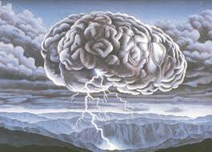
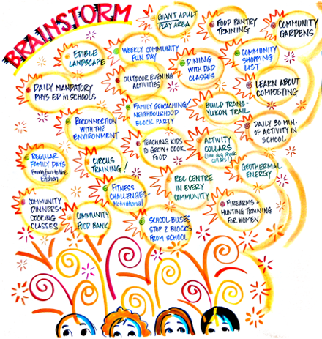
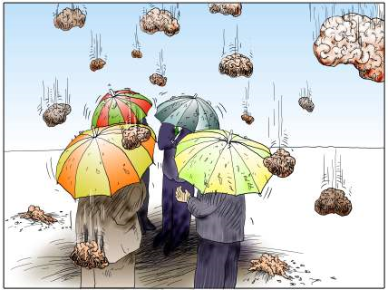
Brainstorm
Notes:
First, we’re going to do some brain storming. What is brainstorm? It is not this…[pic 1] or this [pic 2], but is this: [pic 3].
We’re going to brainstorm about Christmas. I want to know how much you know about it.

Slide 9
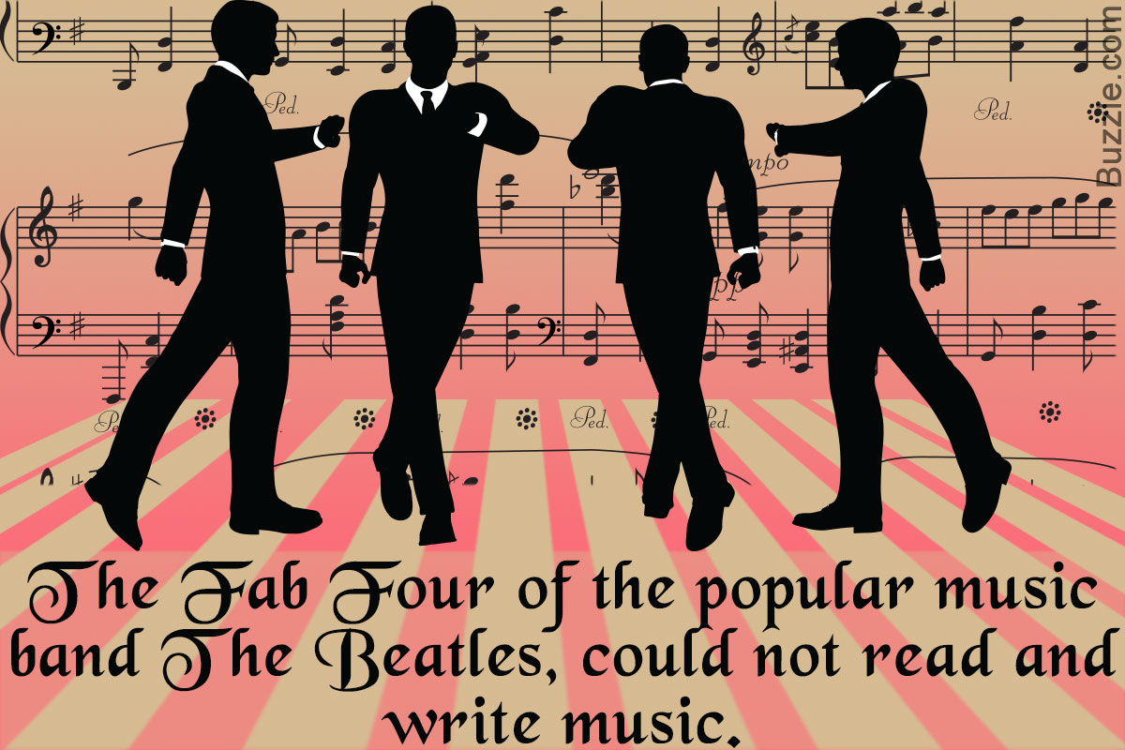
MYTH: If you can’t read music, you can’t compose.
Famous musicians who couldn’t read music include
the Beatles
Elvis Presley
Eric Clapton
Slash.
Maybe you!

Slide 10
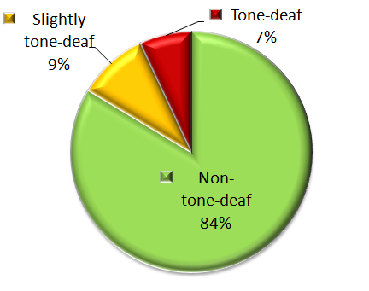
MYTH: Tone Deafness
Less than 1 in 25 people truly has amusia, the technical term for tone deafness. Tests have shown that some people with bad singing voices hear music just fine. Amusics are a smaller group with a perceptual problem: They can't pick out differences in pitch or follow the simplest tunes.
The Pitch Recognition Test (Distorted Tunes Test)
Another Tone Deafness Test

Slide 11
MYTH: Tone Deafness
Here’s the real test:
How do you say these Chinese words:
吗
嘛
妈
马
骂
If you can say them with the proper tones, then you are not tone deaf!
This also means that if you can speak Chinese, you hear well enough that you can learn to sing and play in tune!

Slide 12
MYTH: Can’t perform music
Music is a language, just like Chinese and English.
You can learn to speak a language without knowing how to read or write it.
You can learn to speak music without knowing how to read or write it.

Slide 13
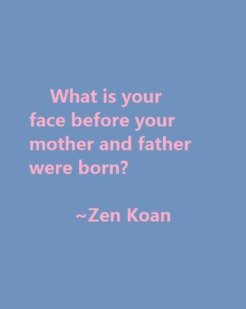

Slide 14
Some Philosophy—Five Buddhist-styled Koans
If a tree falls in a forest and no one is around to hear it, does it make a sound?
What is the sound of one hand clapping?
Which came first—language or music?
Can we say that the song of a bird is music?
Is all music beautiful?

Slide 15
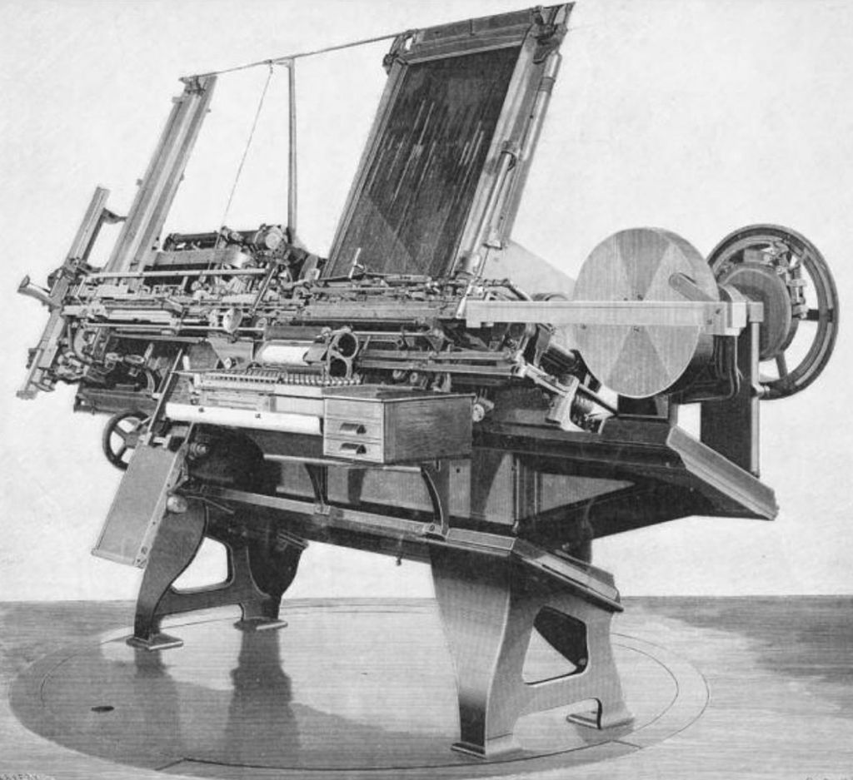
What is compose?
[Middle English composen, from Old French composer, alteration (influenced by poser, to put, place) of Latin compōnere
com·pose
(kəm-pōz′)
v. com·posed, com·pos·ing, com·pos·es
v.tr.
1. To make up the constituent parts of; constitute or form: an exhibit composed of French paintings; the many ethnicgroups that compose our nation. See Usage Note at comprise.
2. To make or create by putting together parts or elements.
3. To create or produce (a literary or musical piece).
4. To make (oneself) calm or tranquil: Compose yourself and deal with the problems logically.
5. To settle or adjust; reconcile: They managed to compose their differences.
6. To arrange aesthetically or artistically.
7. Printing To arrange or set (type or matter to be printed).
v.intr.
1. To create a literary or musical piece.
2. Printing To set type.

Slide 16
Music as Language

Slide 17
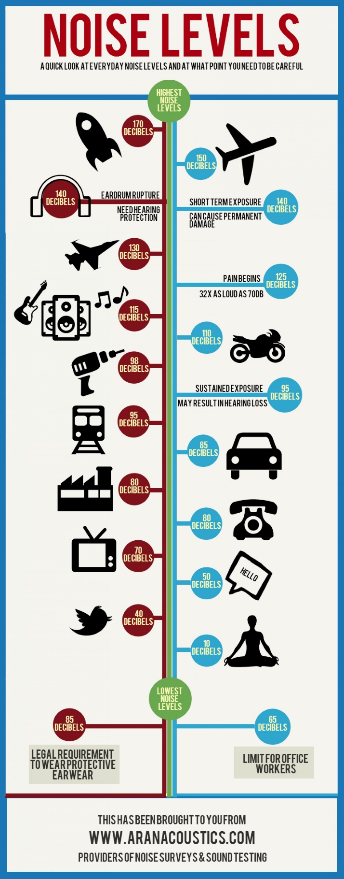
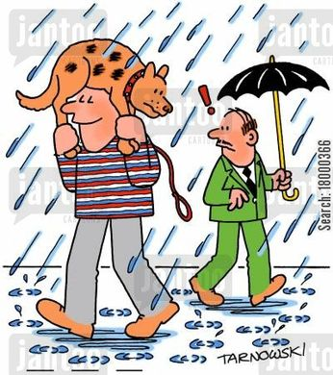
Some (ugh!) Vocabulary
Decomposition
Composition
Improvise—Improvisation
Sound (Back to the Future video exerpt)
Noise
Vibration
Sound waves
Music
Musical

Slide 18
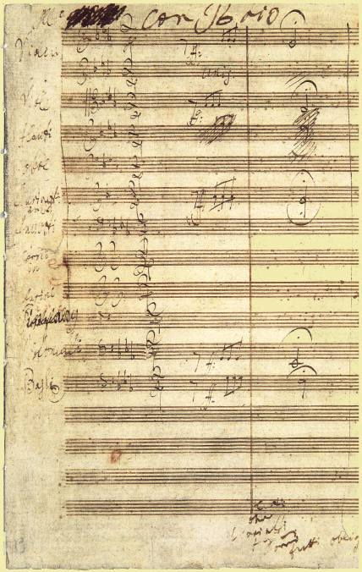
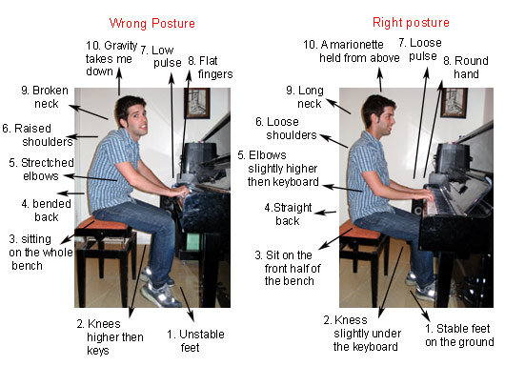
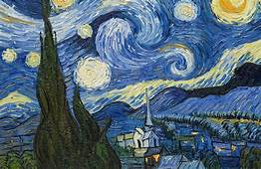
Aesthetics—Beautiful or not? More Vocab.
Skill
Craft
Art
Entertainment

Slide 19
If you can speak, you can create poems and stories

Slide 20
If you can speak, you can create and songs poems and stories and songs
Let’s do it!

Slide 21
Listening
There are ten questions to keep in the back of your mind.

Slide 22
The Ten Questions
Go outside and listen. (If you can’t go outside, then stay inside and do this in your imagination.)
In your notebook, write down your answers to the following ten questions:

Slide 23
The Ten Questions (cond.)
What kind of sounds do you hear?
Do they sound high or low?
Do they last a long time or are they short?
Which sounds, if any, seem to communicate (seem to say something)?
Which sounds are beautiful and which are ugly?
Which sounds are loud and which are soft?
Which sounds seem to stay the same and which seem to move up and down?
Which sounds let you clap your hands at the same time you hear the sounds if you hear them more than once?
Where do the sounds come from?
What are the things that are making the sounds?

Slide 24
The Ten Questions (cond.)
Did you discover anything new from this exercise?
Try this exercise:
You live on an uncharted island, and you know nothing about music notation. What kind of notation might you invent to represent lengths of sounds? Remember, you’re isolated; no cell phones, no clocks. Consider yourself lucky you have things to write with!

Slide 25
Homework
Listen to your world!
Think about how you could put together sounds to express what you hear.
Think about how you could put together sounds to express how you feel.

