Slide 1
Lover’s Waltz
Don Rechtman
Notes:
上台

Slide 2
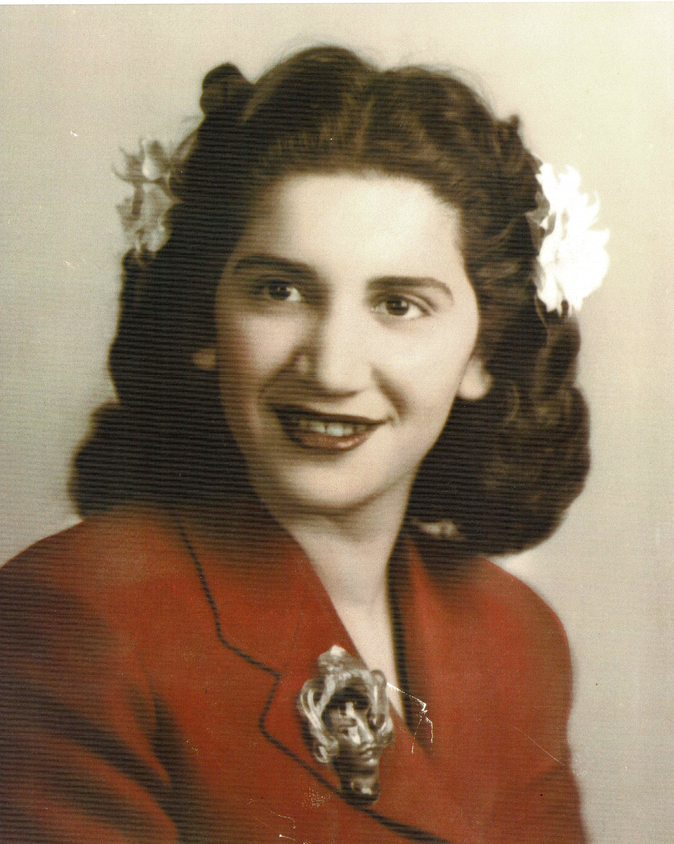
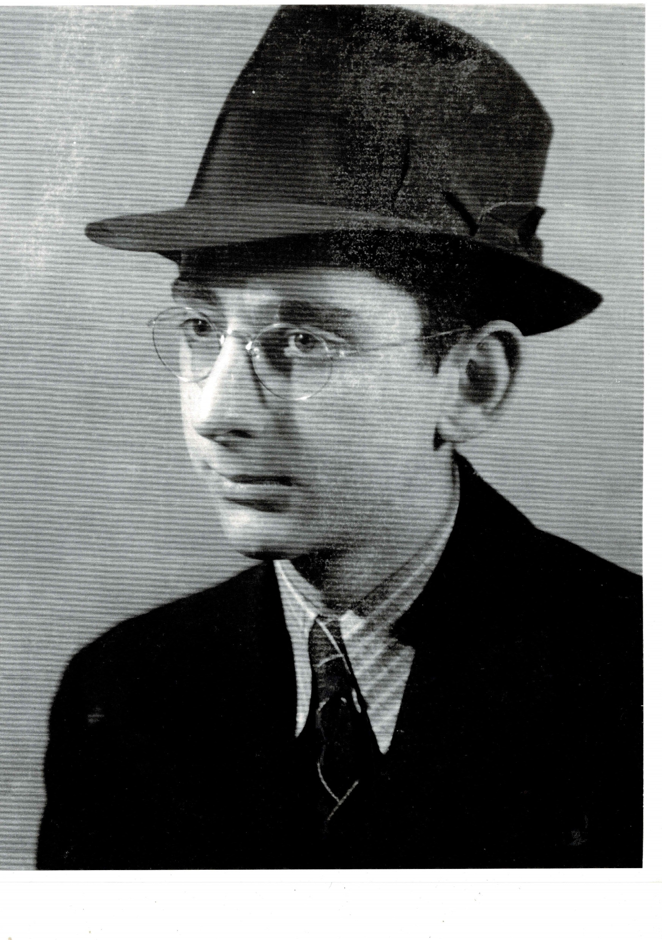
“Lover’s Waltz" was written for Don’s parent’s 50th wedding anniversary.
Notes:
东开始讲话。中间还有一个邀请观众环节

Slide 3
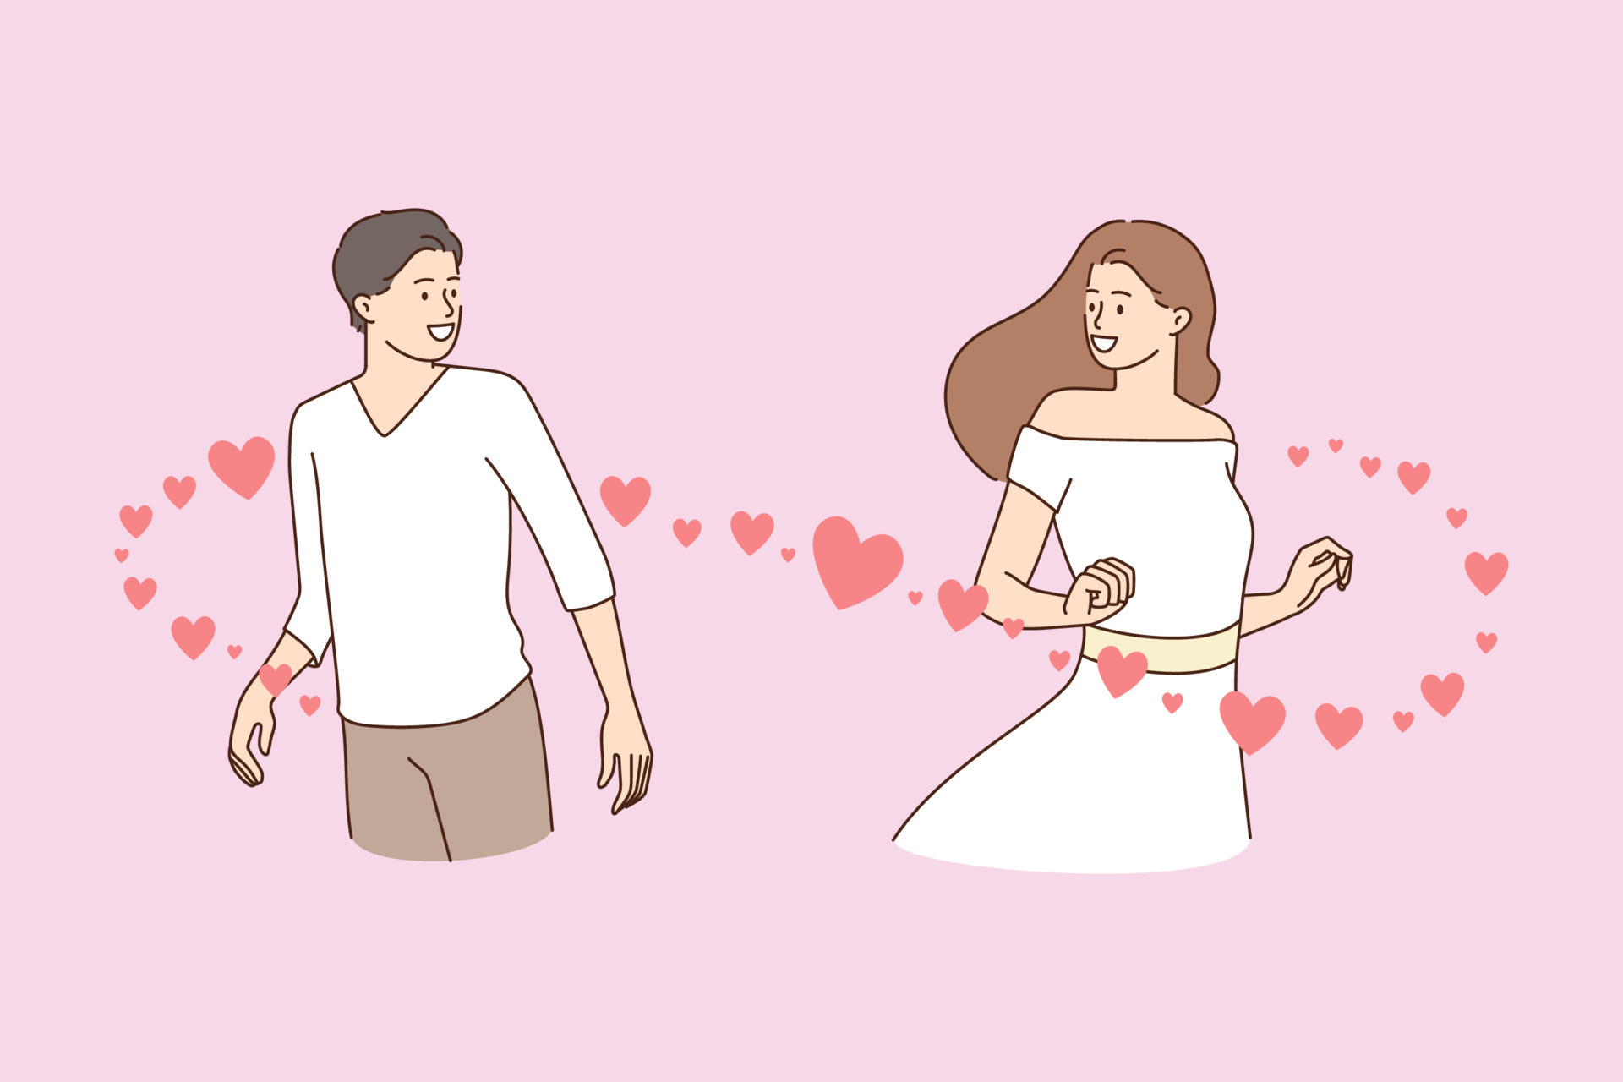
When our eyes met, our hearts both were set
目光初遇，心已默许
Notes:
开始演唱

Slide 4
For singing and dancing the lover’s waltz.
来歌唱来舞蹈，恋人华尔兹。

Slide 5
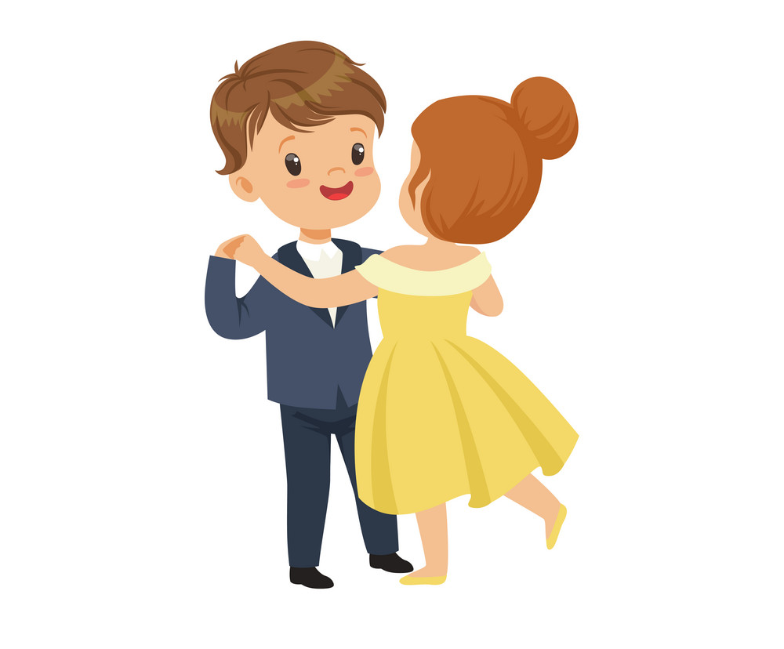
Singing, my love is, and dancing, my love is,
歌唱吧，我的爱，舞蹈吧，我的爱，

Slide 6
We were singing and dancing the lover’s waltz.
我们歌唱 我们舞蹈，恋人华尔兹。

Slide 7
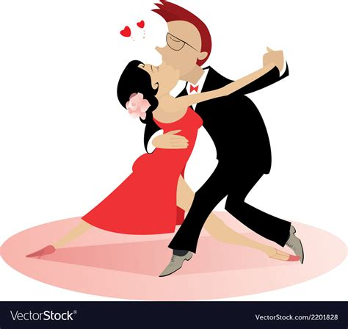
In our love we would move as one,
爱 恋中我 们合二为一，

Slide 8
Both singing and dancing the lover’s waltz;
一起歌唱 一起舞蹈，恋人华尔兹；

Slide 9
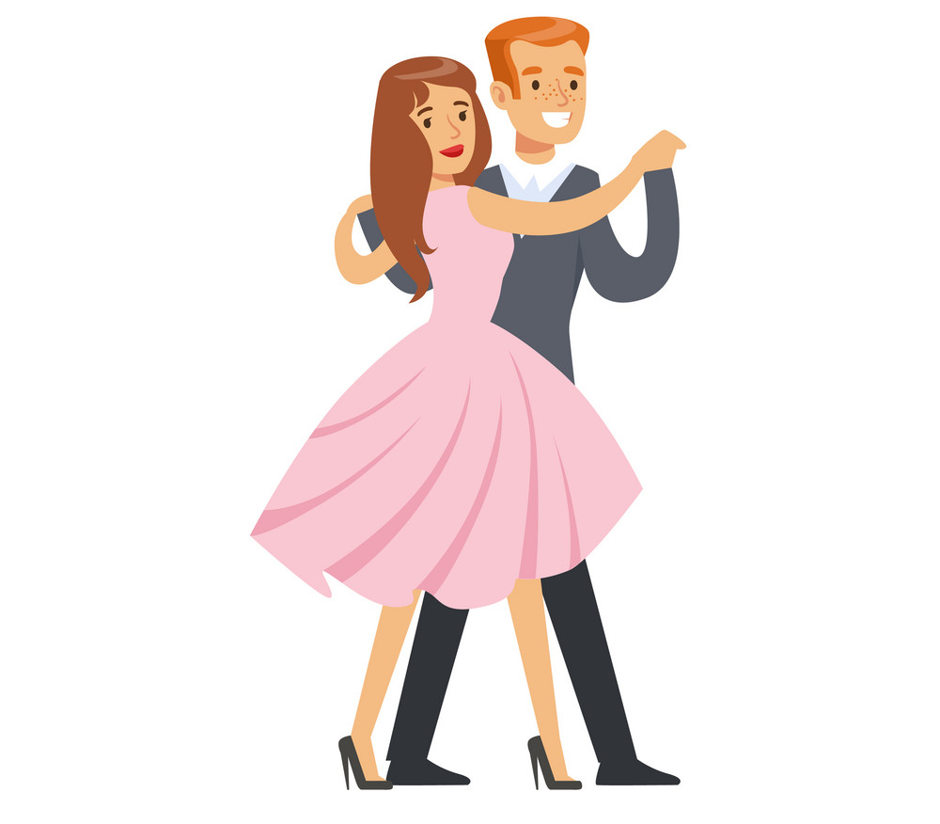
We were singing and dancing the lover’s waltz.
我们歌唱 我们舞蹈，恋人华尔兹。

Slide 10
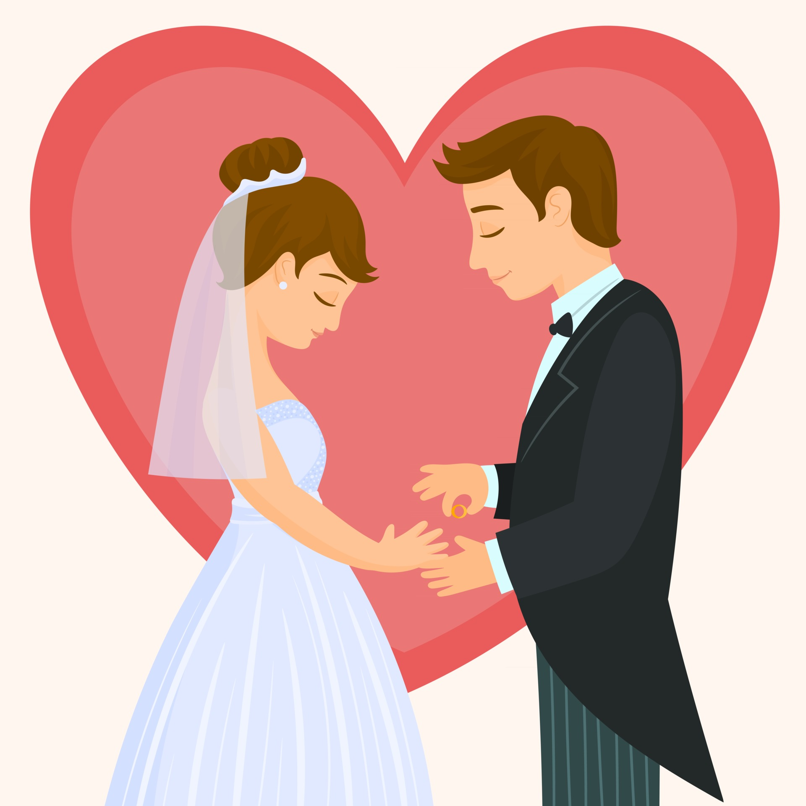
When we were married, our hearts were carried
婚姻殿堂，同心永结

Slide 11
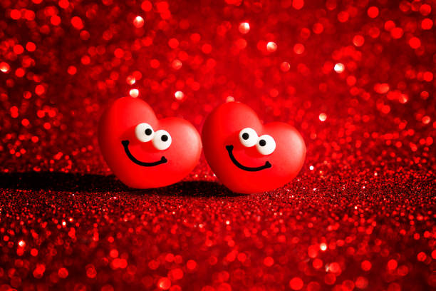
Side by side by the lover’s waltz.
肩并肩随着 恋人华尔兹。

Slide 12
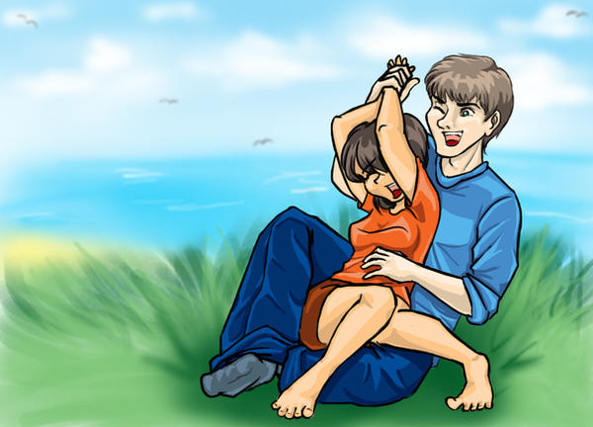
Singing, my love is, and laughing, my love is,
唱歌吧，我的爱，欢笑吧，我的爱，

Slide 13
We were singing and dancing the lover’s waltz.
我们歌唱 我们舞蹈，恋人华尔兹。

Slide 14
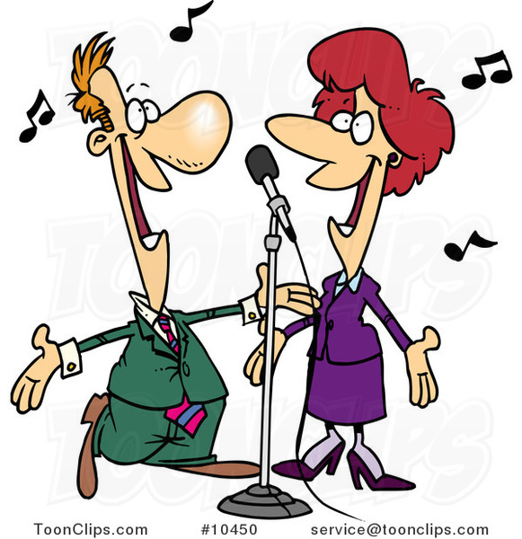
Singing and dancing the lover’s waltz;
唱着歌，跳着舞，恋人华尔兹；

Slide 15
We were singing and dancing the lover’s waltz.
我们歌唱 我们舞蹈，恋人华尔兹。

Slide 16
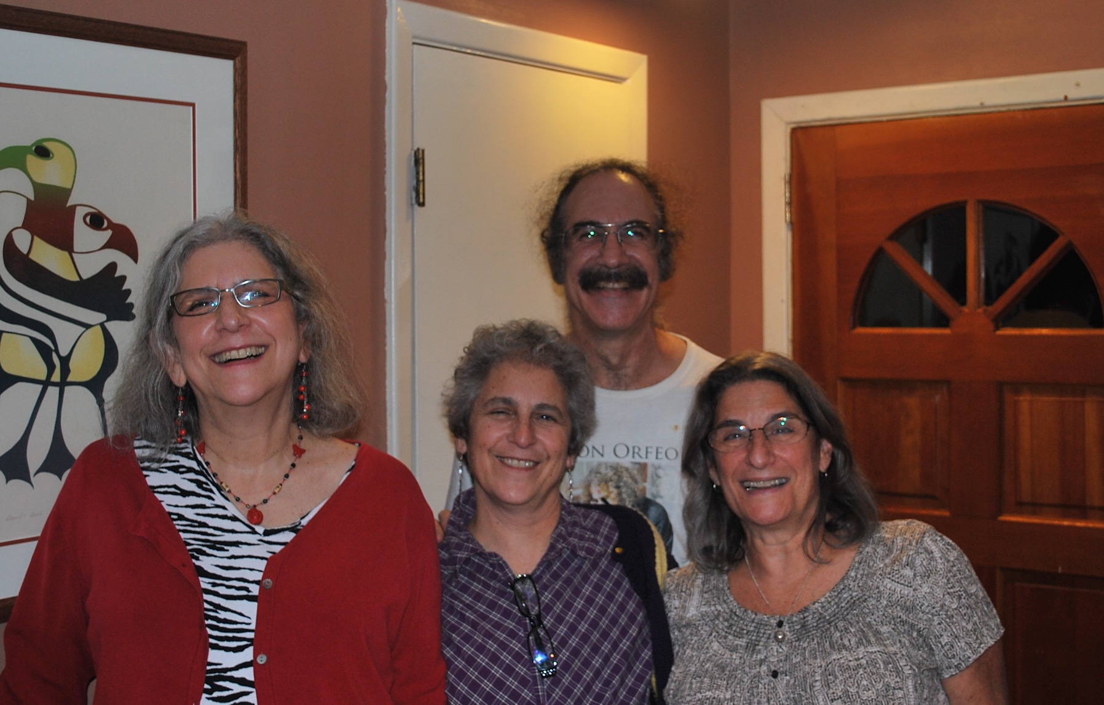
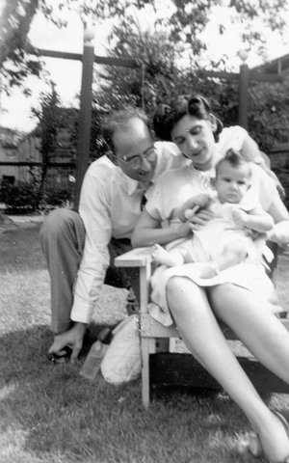
Our children grew, and our hearts did, too,
你我心灵 随儿女成长，

Slide 17
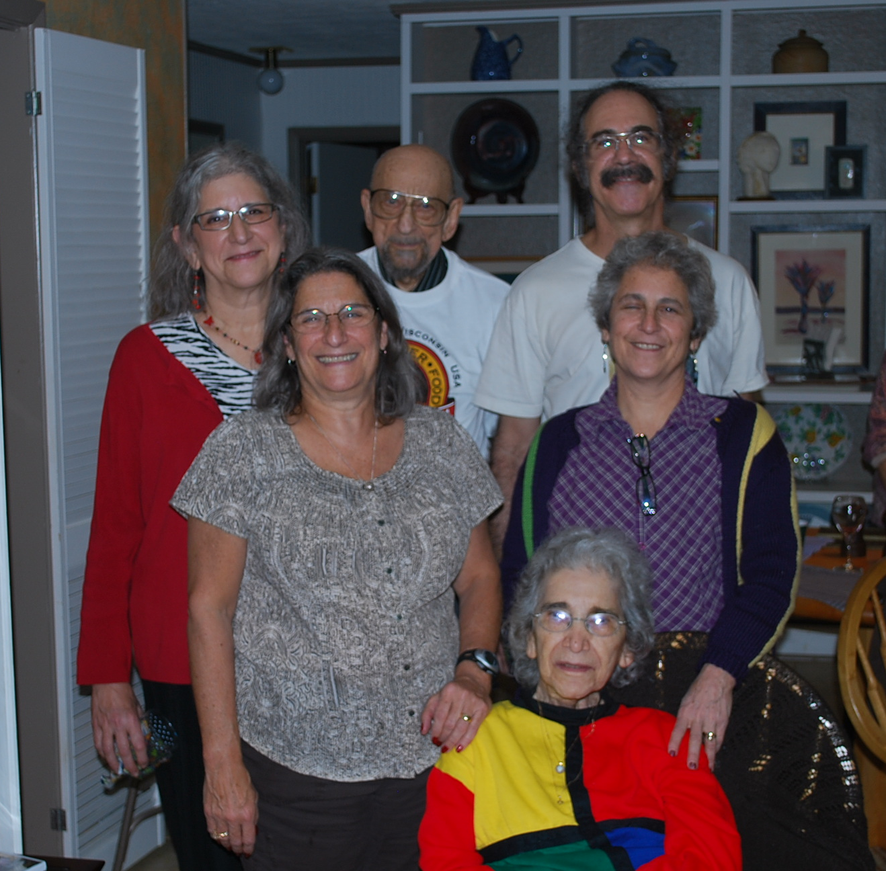
We grew while dancing the lover’s waltz.
我们一同成长,恋人华尔兹。

Slide 18
Singing, my love is, and dancing, my love is,
歌唱吧，我的爱，舞蹈吧，我的爱，

Slide 19
We were singing and dancing the lover’s waltz.
我们歌唱 我们舞蹈，恋人华尔兹。

Slide 20
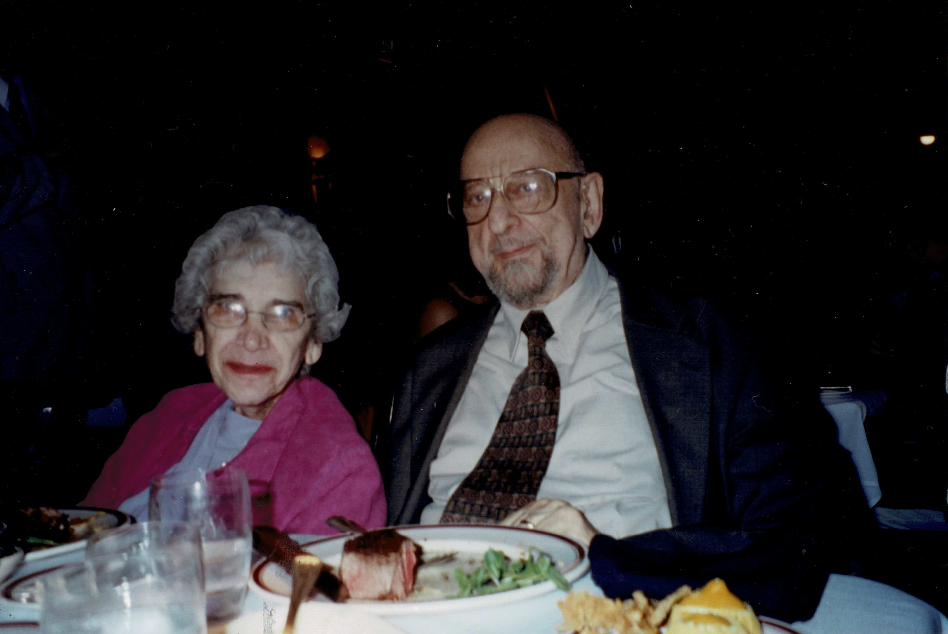
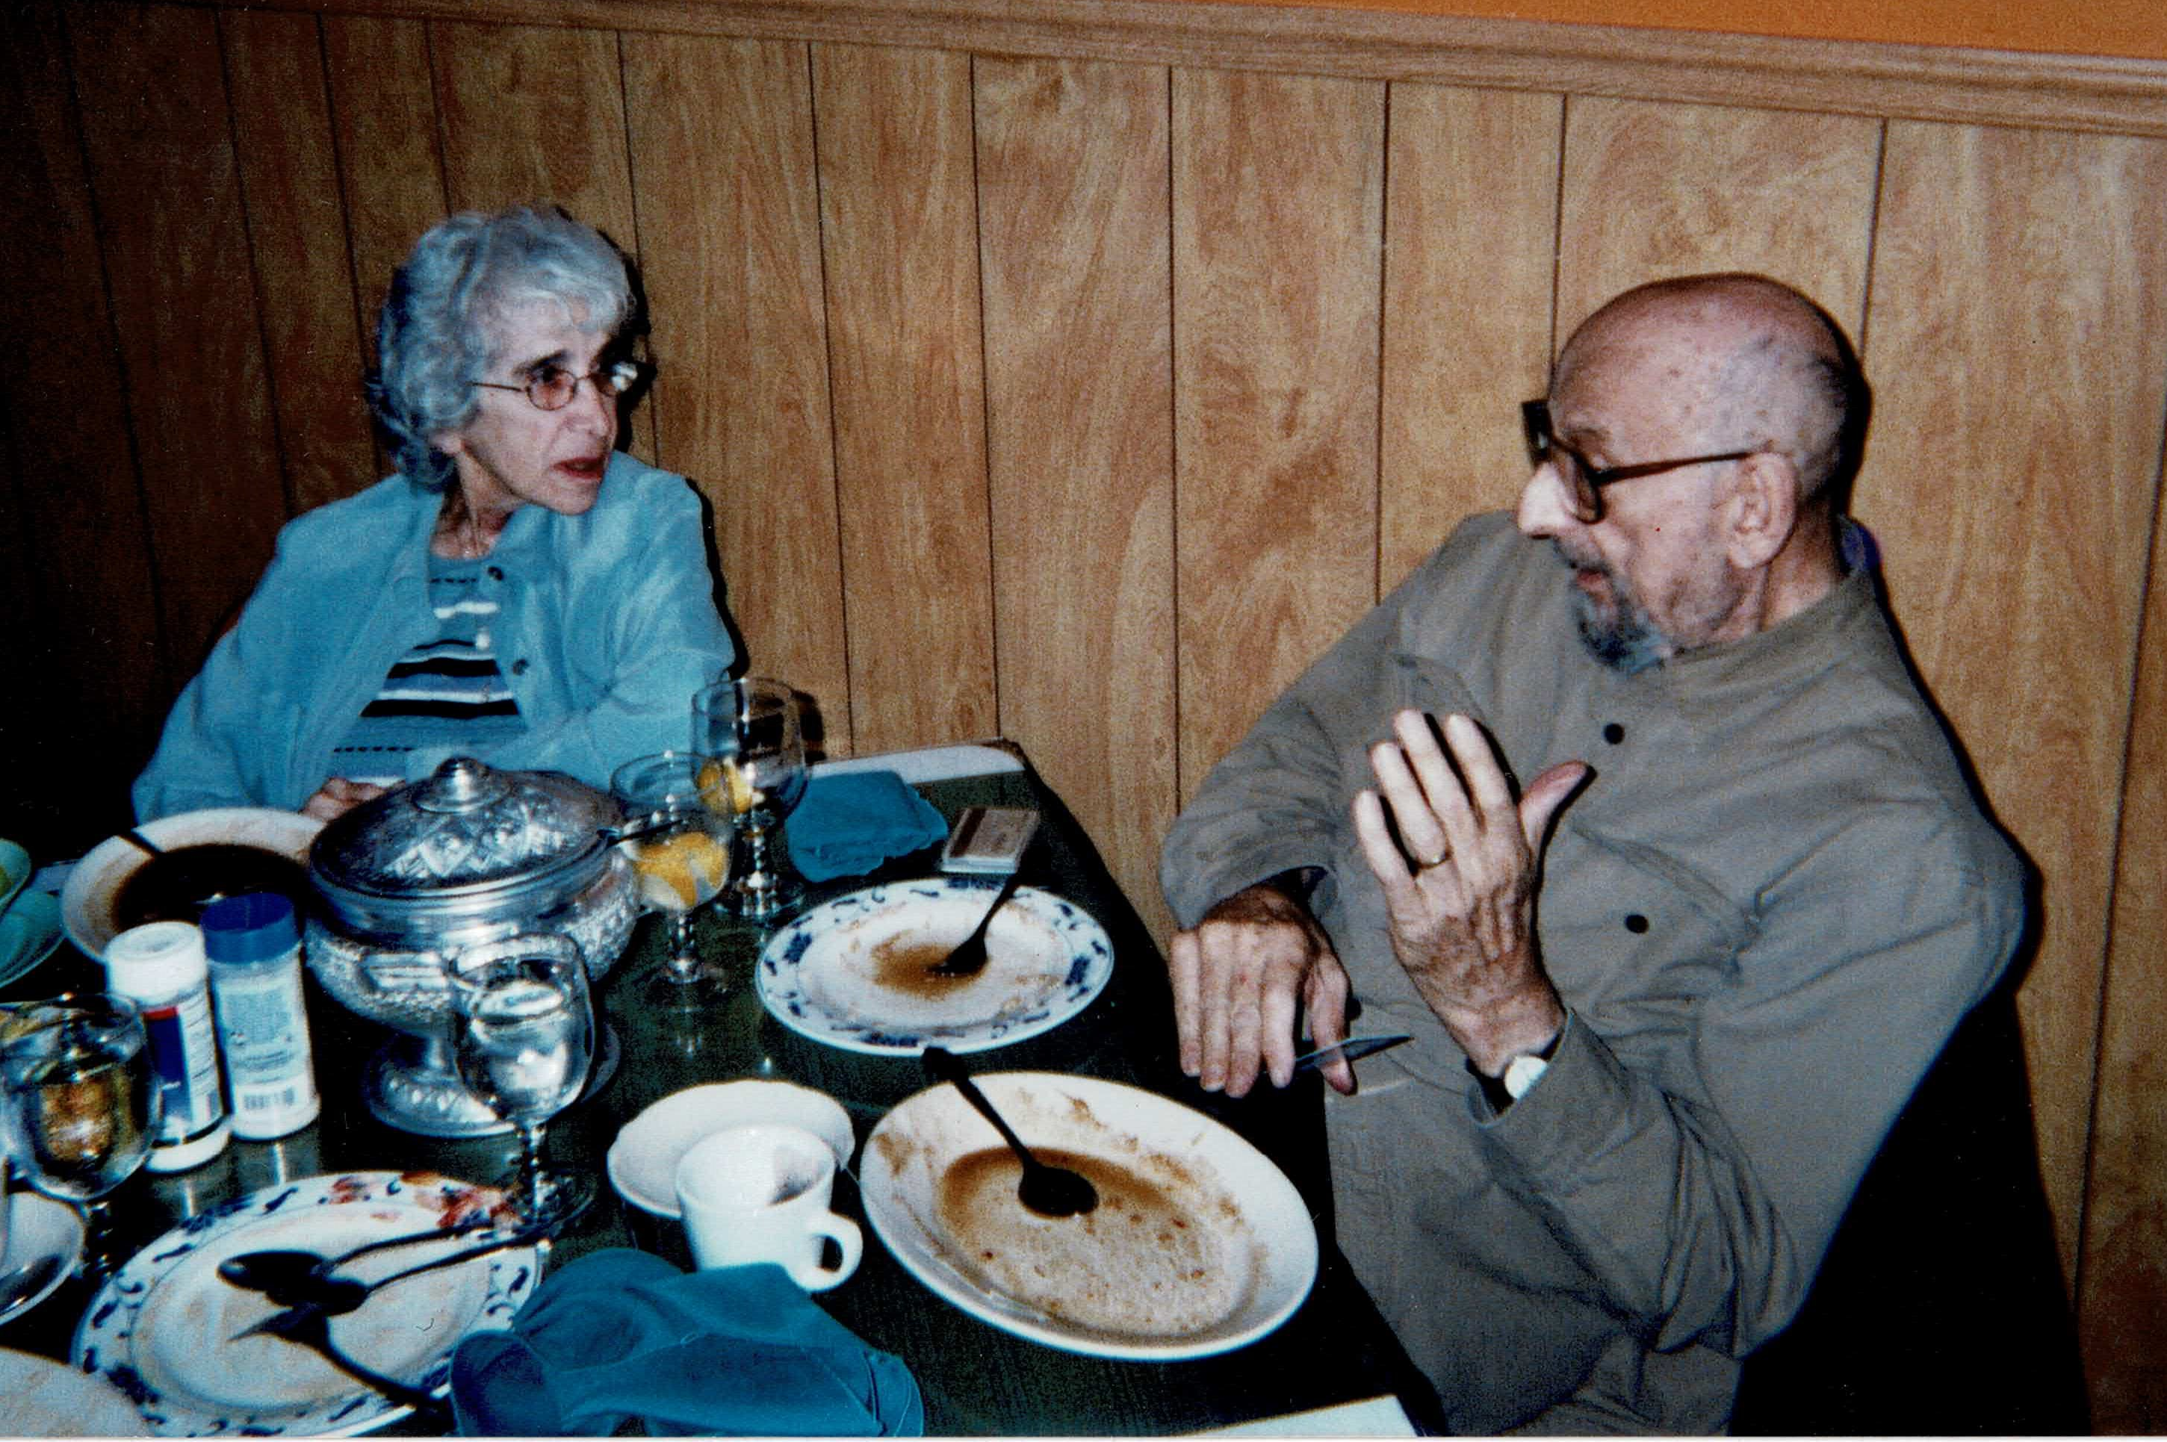
We’ve had our bad times, but we’ve had our good,
有艰 难岁 月，也有快乐 时光，

Slide 21
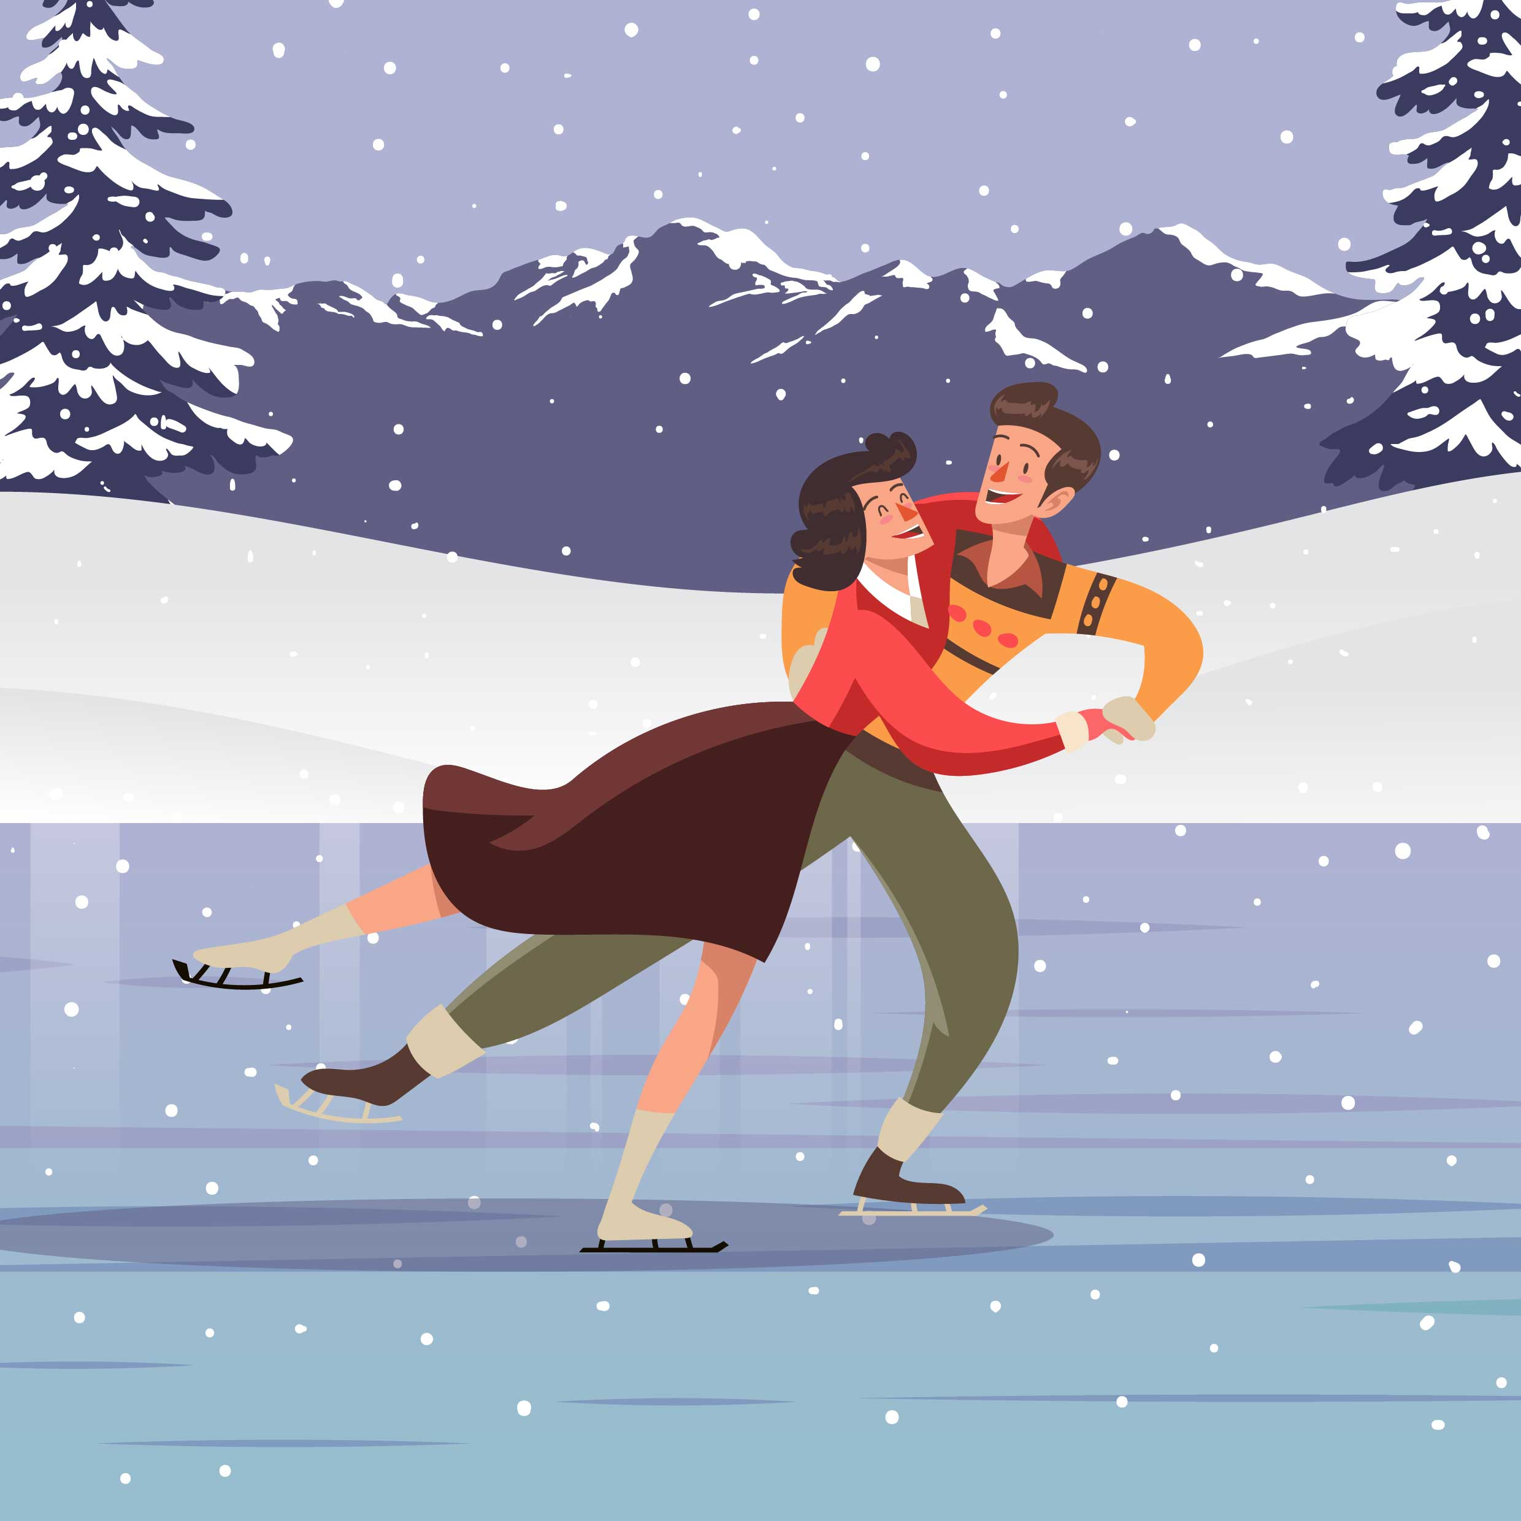
And we’ve glided through with the lover’s waltz.
一切都划过在恋人华尔兹。

Slide 22
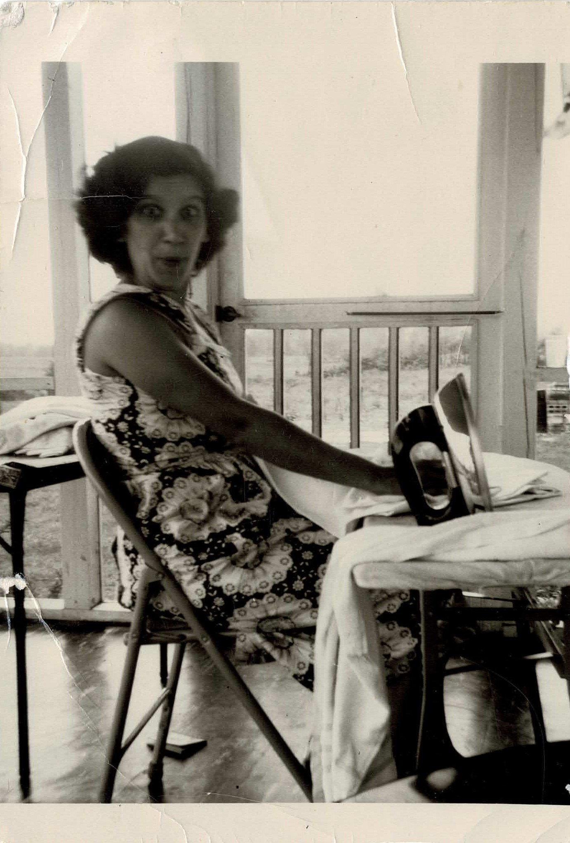
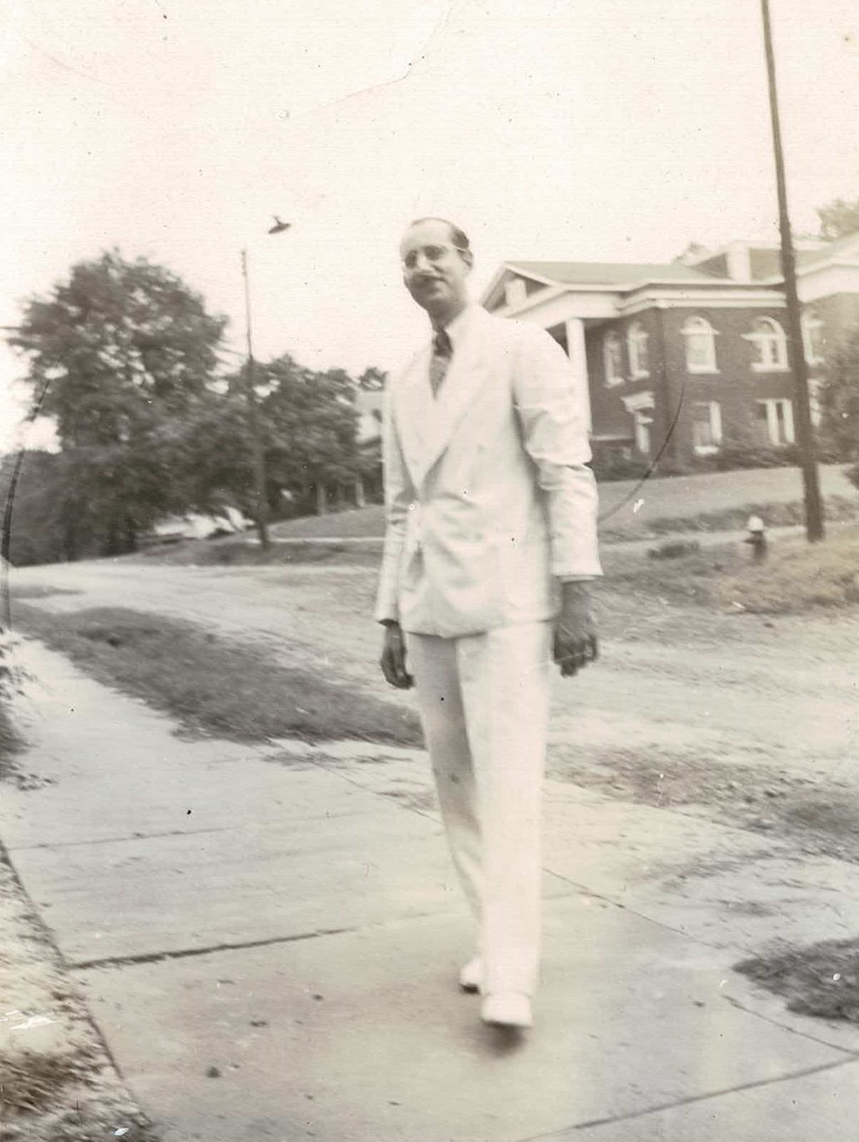
Notes:
音乐响起时再换下一张幻灯片

Slide 23
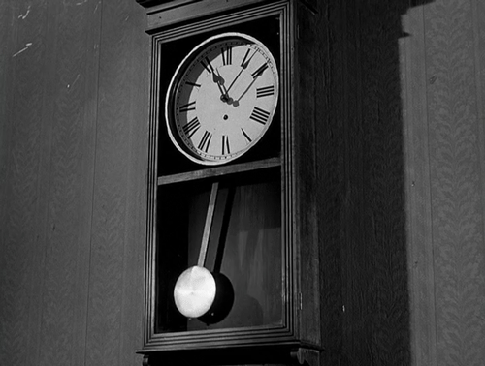

Slide 24
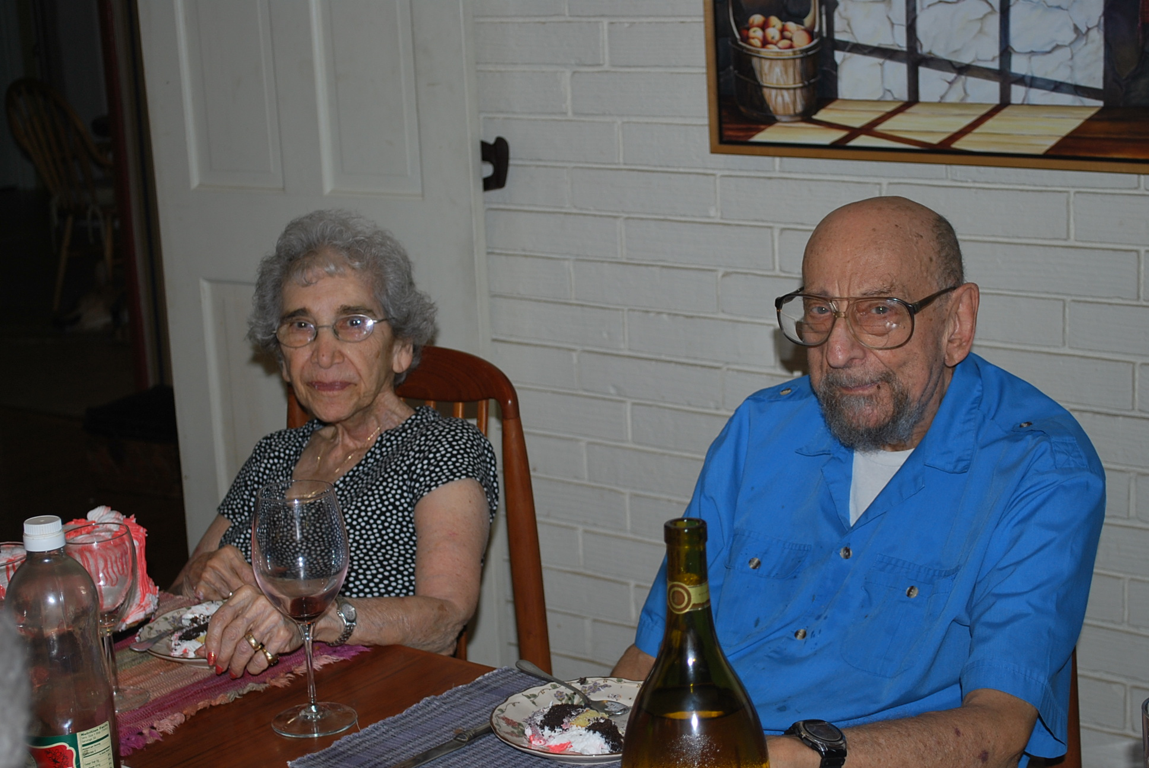
When we grew old, our hearts grew not cold,
我们老去，心却未寒,

Slide 25
We kept them both warm with the lover’s waltz.
在恋人舞曲中，我们心心相暖。

Slide 26
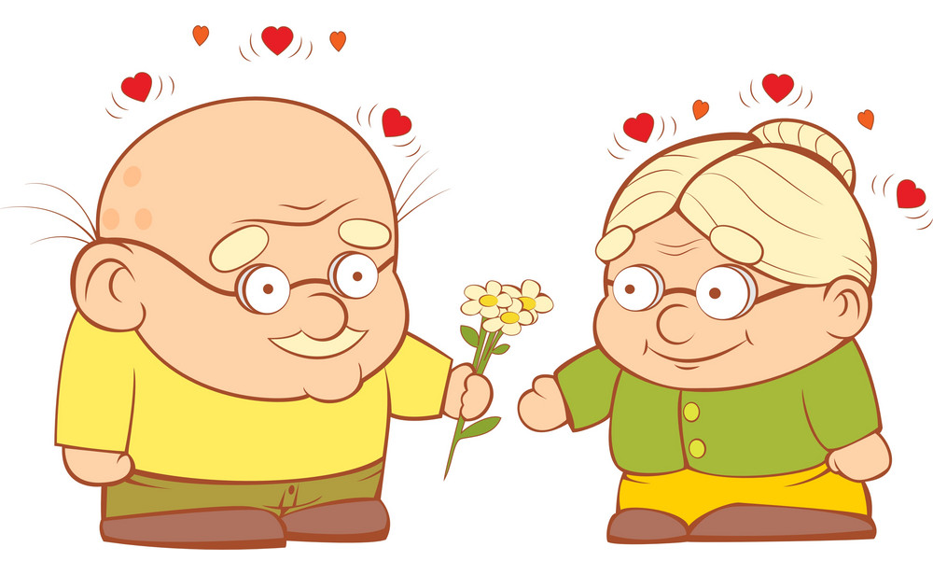
Now, when our eyes meet, our hearts turn to feet
如今对视，心来舞蹈

Slide 27
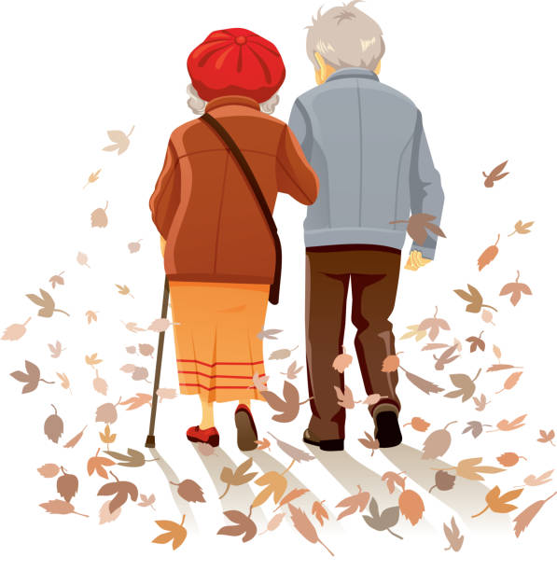
And in old age we still dance the lover’s waltz.
老年我们依旧跳恋人华尔兹。

Slide 28
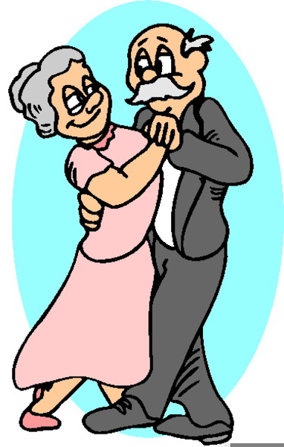
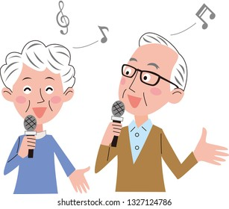
Singing and dancing the lover’s waltz.
唱着歌，跳着舞，恋人华尔兹。

Slide 29
We’re still singing and dancing the lover’s waltz!
我们仍然歌唱，我们跳起恋人华尔兹!

Slide 30
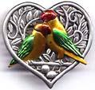


1925 — 2013
1946 — 2013
1922 — 2013

