Slide 1
I am Don “Orfeo” Rechtman
I write classical Western music, but I’m not very famous;
I’m a composer of little note.
Notes:
I am Don; my stage name is Don Orfeo. Today I’m going to introduce you to the power of remorse. What better place to start than to talk about…[click]

Slide 2

I know it’s supposed to be a chemistry class, but I’m going to talk instead about the hidden power of remorse.
This is actually applied chemistry: even a chemist can have remorse for something!
re·morse (rĭ-môrs′)
a sense of deep regret and guilt, usually for some misdeed

Slide 3
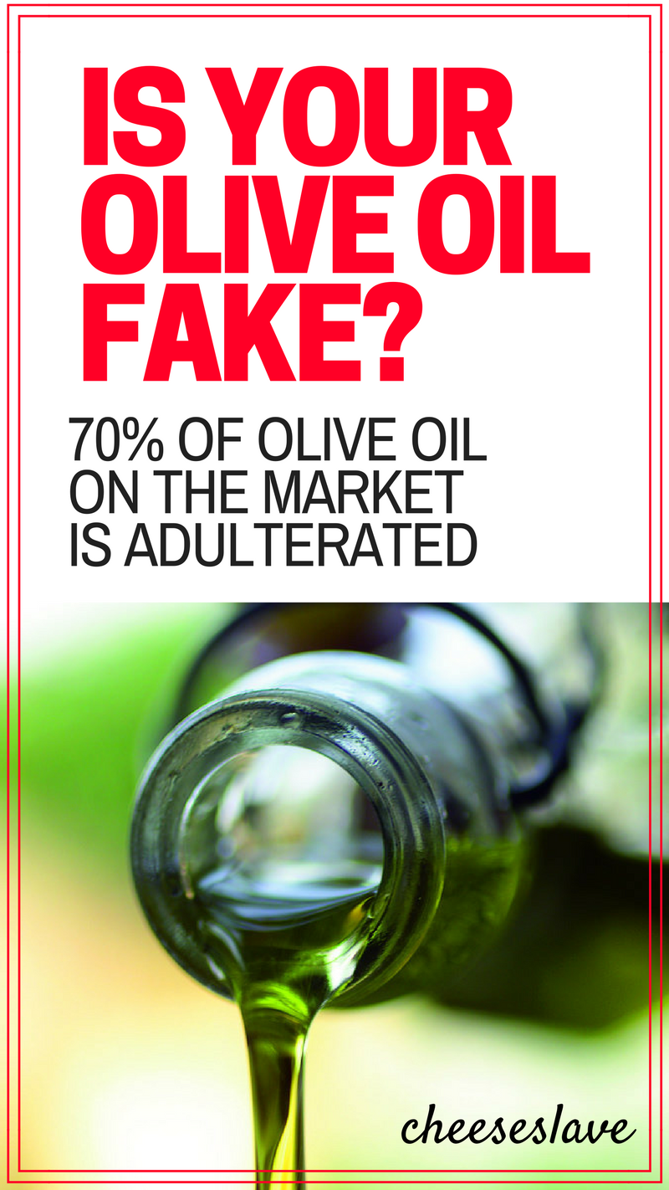
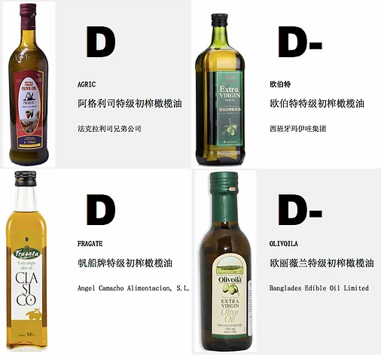
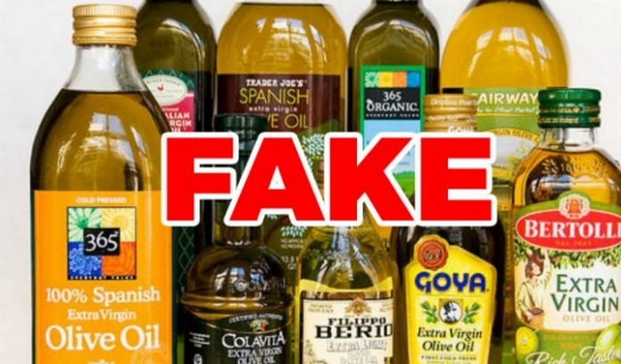
70% of U.S. Olive Oil is Fake!!!
Chinese olive oil could be worse.
Notes:
Olive oil! Most U.S. olive oil is fake. It is cut with other oils, and may have flavorings and colors added. I don’t have any stats on Chinese olive oil, but we can presume that, due to lax regulations, it could be worse. However, [click]

Slide 4
You can find high-grade
extra virgin olive oil.
Authentic olive oil can be of Greek, Italian, or Spanish origin; extra virgin olive oil is of the highest class.
If you know the source, you may also find real olive oil you can trust from olives in Australia and California.
Notes:
You can find the real thing here. (read slide)

Slide 5
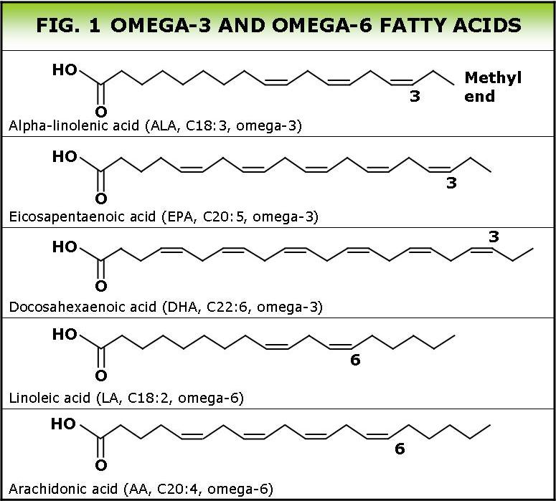
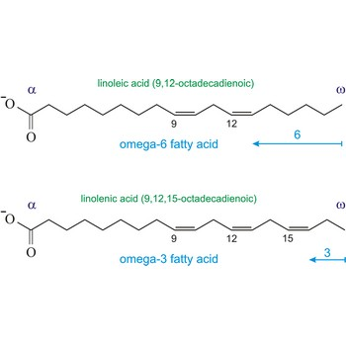
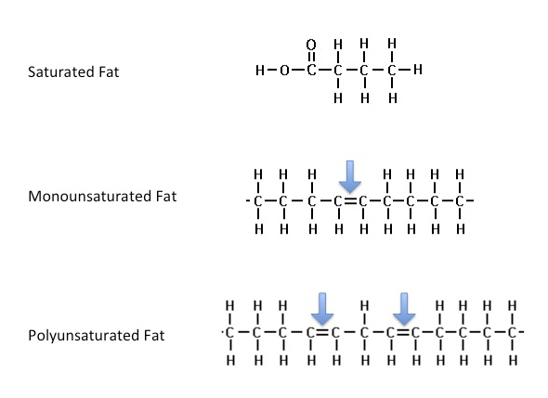
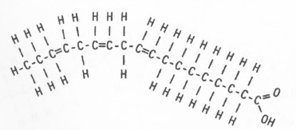
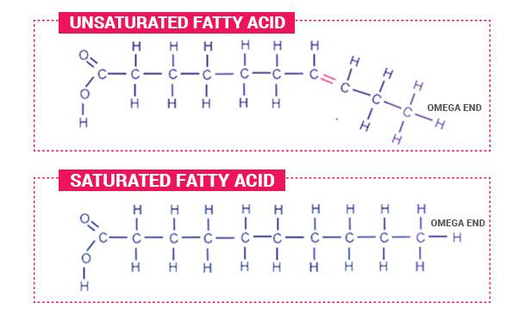
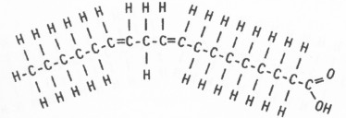
Olive oil includes oils that improve your health; some are actually absorbed through the skin.
Let’s find out about Omega-3 and Omega-6 fatty acids:
Linolenic acid
Linoleic acid
Notes:
Olive oil includes oils that improve your health; some are actually absorbed through the skin. Among other components, it contains omega-3 fatty acids, a fancy name for one of the oils that is essential to good health and that the body likes everywhere, including the skin. When there’s enough omega-threes, the skin feels soft and supple; when in short supply, the skin may feel dry, or even actually oily if and when the body substitutes less desirable oils.
I happen to have a bottle of authentic olive oil here. I would like a volunteer who would like to experience the benefits of olive oil first hand, that is, a little drop on the back of the first hand, then rub it into the skin of both hands. How does that feel?

Slide 6
A volunteer…
Notes:
Now, I have another common substance that most people commonly apply to the skin. I will again ask for a volunteer, but first I’d like to describe it for you.

Slide 7
Now…
Here is another common substance. Most people commonly apply this to the skin daily.
I will again ask for a volunteer, but first, I’d like to describe it to you…
Notes:
Now, I have another common substance that most people commonly apply to the skin. I will again ask for a volunteer, but first I’d like to describe it for you.

Slide 8
This is a cocktail of about 4,000 ingredients including 80 cancer-causing chemicals.
Some are known to have the potential to induce cancer upon contact.
Notes:
This is a cocktail of about 4,000 ingredients including 80 cancer-causing chemicals, some of which are known to have the potential to induce cancer upon contact. Some of the more notable ingredients include tars, sticky gooey substances that help hold the other stuff to the skin and are cancer inducers in their own right; formaldehyde, a well-known carcinogen; and cadmium, a single molecule of which can transform a healthy DNA strand into a cancer-causing one if it happens to show up at the wrong place at the wrong time.
Any volunteers?
I introduced this substance by saying most of us apply it to our skin on a daily basis. We may not be doing it intentionally, and most don’t even know they are doing it at all.
I know most of you are already aware of what this substance is, but I want to hold off officially announcing it for at least one more slide, because…

Slide 9
Some of the more notable ingredients include tars, sticky gooey substances that help hold the other stuff to the skin and are cancer inducers in their own right; formaldehyde, a well-known carcinogen; and cadmium, a single molecule of which can transform a healthy DNA strand into a cancer-causing one if it happens to show up at the wrong place at the wrong time.
Notes:
This is a cocktail of about 4,000 ingredients including 80 cancer-causing chemicals, some of which are known to have the potential to induce cancer upon contact. Some of the more notable ingredients include tars, sticky gooey substances that help hold the other stuff to the skin and are cancer inducers in their own right; formaldehyde, a well-known carcinogen; and cadmium, a single molecule of which can transform a healthy DNA strand into a cancer-causing one if it happens to show up at the wrong place at the wrong time.
Any volunteers?
I introduced this substance by saying most of us apply it to our skin on a daily basis. We may not be doing it intentionally, and most don’t even know they are doing it at all.
I know most of you are already aware of what this substance is, but I want to hold off officially announcing it for at least one more slide, because…

Slide 10
Any volunteers?
Notes:
This is a cocktail of about 4,000 ingredients including 80 cancer-causing chemicals, some of which are known to have the potential to induce cancer upon contact. Some of the more notable ingredients include tars, sticky gooey substances that help hold the other stuff to the skin and are cancer inducers in their own right; formaldehyde, a well-known carcinogen; and cadmium, a single molecule of which can transform a healthy DNA strand into a cancer-causing one if it happens to show up at the wrong place at the wrong time.
Any volunteers?
I introduced this substance by saying most of us apply it to our skin on a daily basis. We may not be doing it intentionally, and most don’t even know they are doing it at all.
I know most of you are already aware of what this substance is, but I want to hold off officially announcing it for at least one more slide, because…

Slide 11
I introduced this substance by saying most of us apply it to our skin on a daily basis. We may not be doing it intentionally, and most don’t even know they are doing it at all.
I know most of you are already aware of what this substance is, but I want to hold off officially announcing it for at least one more slide, because…
Notes:
This is a cocktail of about 4,000 ingredients including 80 cancer-causing chemicals, some of which are known to have the potential to induce cancer upon contact. Some of the more notable ingredients include tars, sticky gooey substances that help hold the other stuff to the skin and are cancer inducers in their own right; formaldehyde, a well-known carcinogen; and cadmium, a single molecule of which can transform a healthy DNA strand into a cancer-causing one if it happens to show up at the wrong place at the wrong time.
Any volunteers?
I introduced this substance by saying most of us apply it to our skin on a daily basis. We may not be doing it intentionally, and most don’t even know they are doing it at all.
I know most of you are already aware of what this substance is, but I want to hold off officially announcing it for at least one more slide, because…

Slide 12
We’ll get to today’s topic soon, but first:
Notes:
Sometimes people show the pictures of the smoker’s lung, but I’m not going to do that.

Slide 13
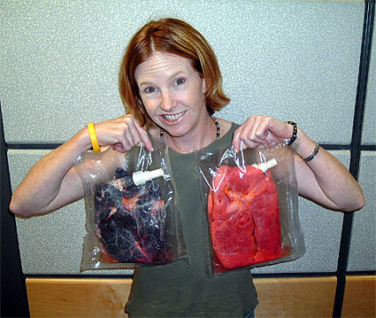
Notes:
Remember this picture? Or at least something like it? Sorry to gross you out, especially if you’ve never seen it before, but many health advocates [CLICK] feel it is important for people to see, especially smokers, especially young people thinking about smoking, and especially everyone else. The theory is, if you see pictures like this, [CLICK] you will be grossed out and decide smoking is not a good thing to do.
And it works, too! [CLICK] Thousands who saw this thought “nope, this is not for me,” and “yep, it’s time to quit,” and they didn’t start, and they did quit. [CLICK] But more than half of Chinese men still smoke, so it doesn’t work for many. Why? To understand why, we must understand [CLICK] what most people think, smokers and non-smokers alike, when they see these pictures: “Ooh, that’s gross; but I’m glad it’s not me!” [CLICK]
Most of us are exposed to it every day, including non-smokers. But how harmful can a little bit be? When we see it coming off a burning cigarette or from the smoker’s mouth, it looks like soft, fluffy, cottony white clouds. It’s actually quite pretty. What kid hasn’t dreamed of blowing perfect, beautiful smoke rings?
The problem is that when you accumulate this white, fluffy stuff, concentrate it into a small area, it stops looking so pretty. So how can you see what it actually looks like, in its concentrated form?

Slide 14
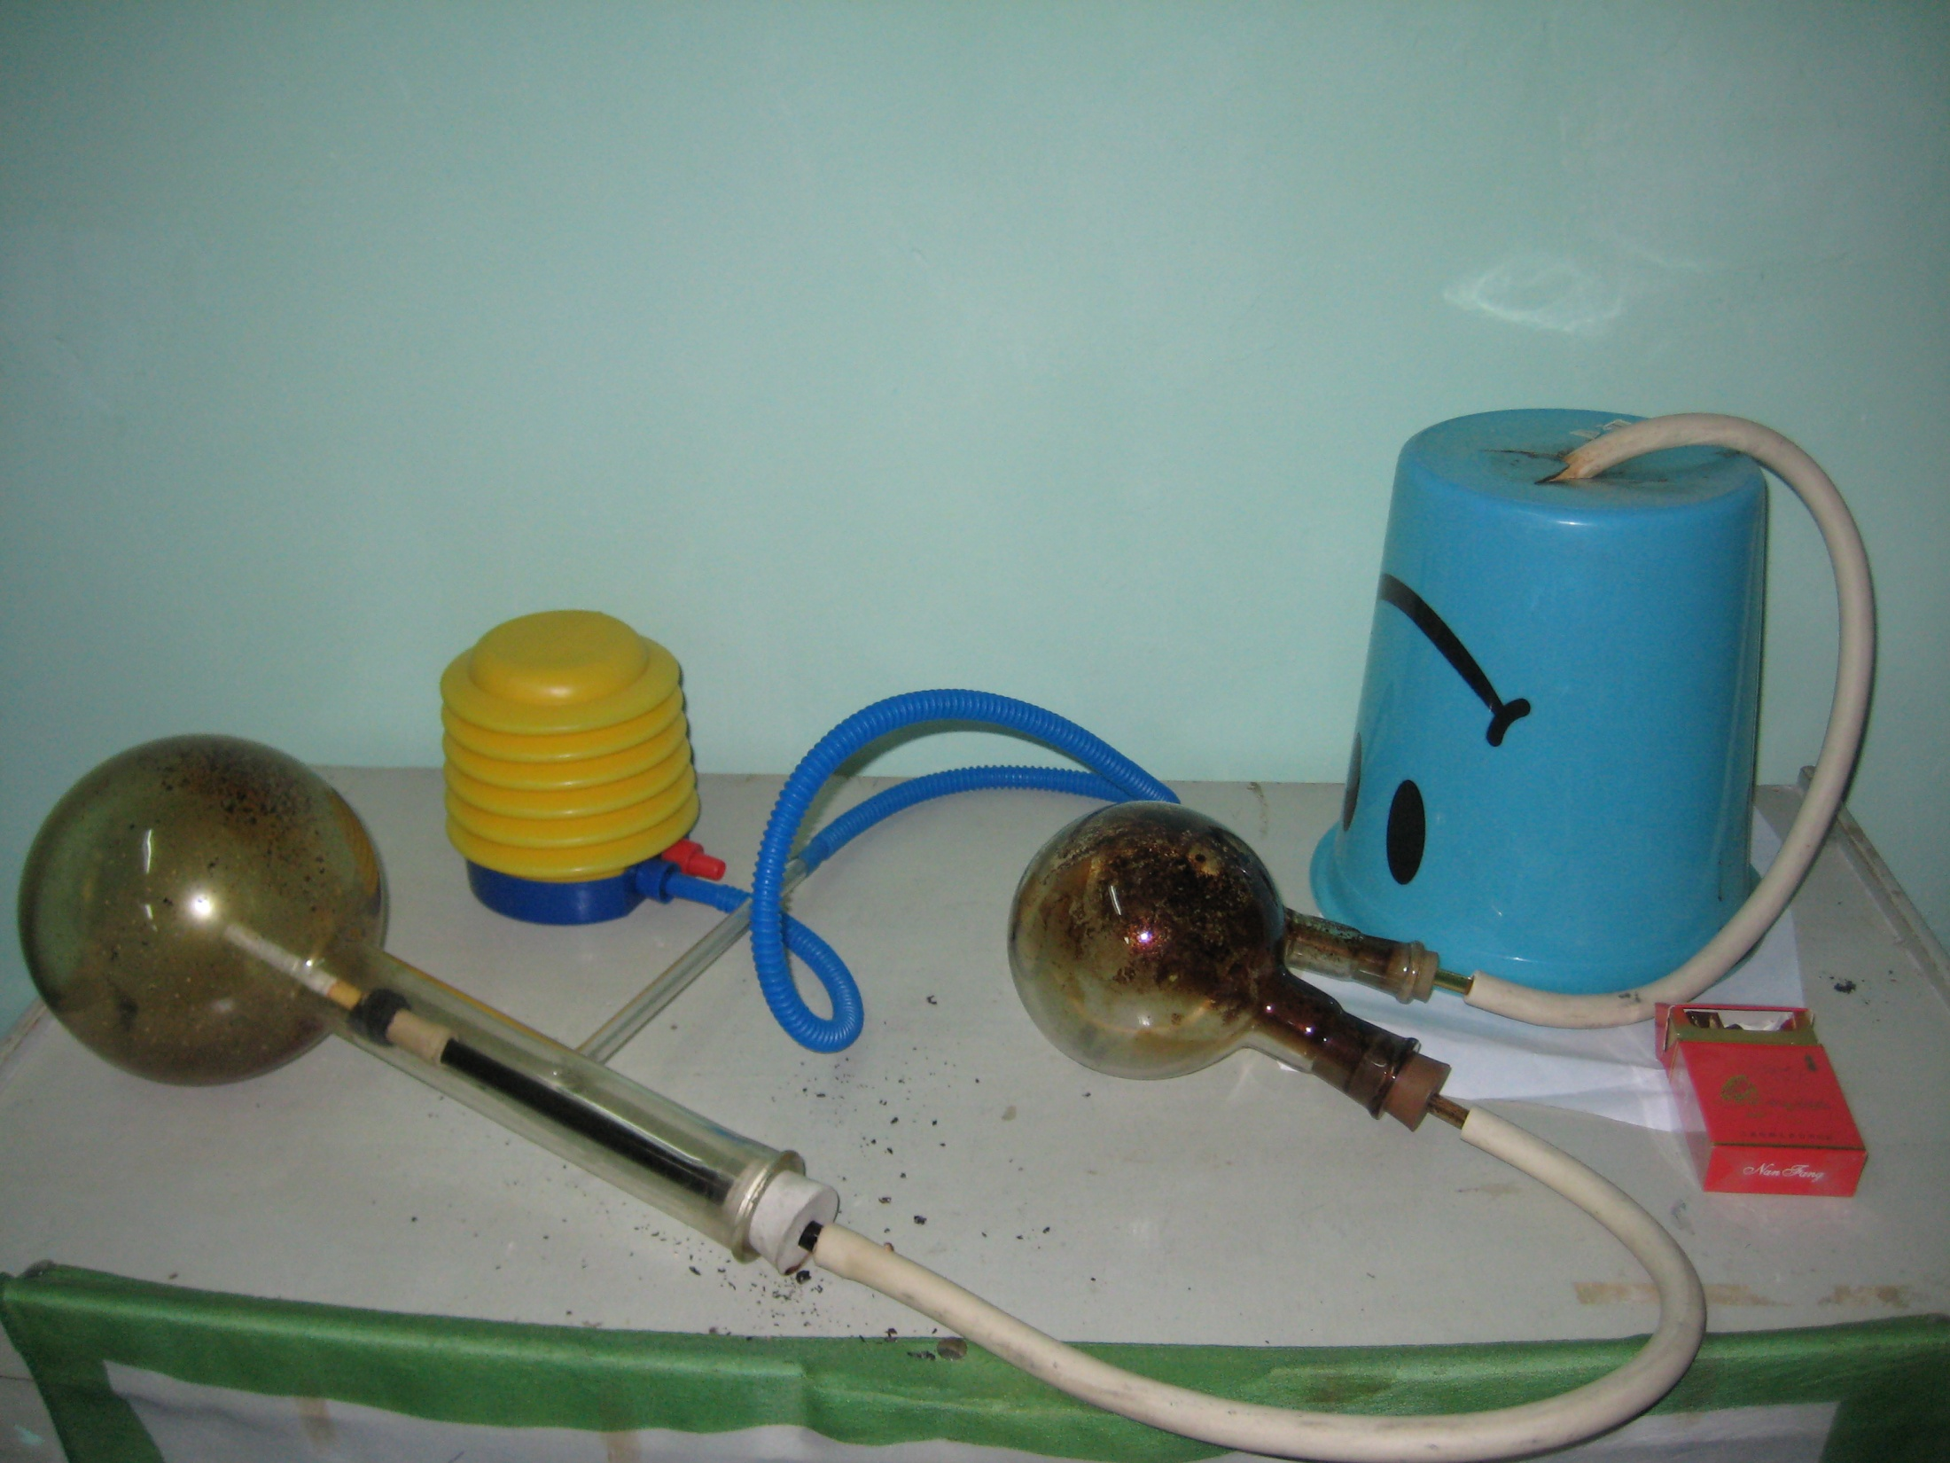
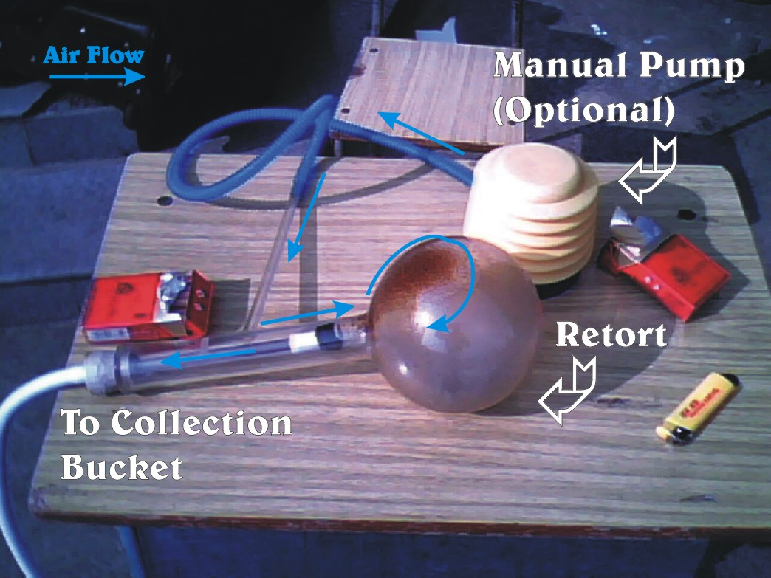
The Smoking Machine
Notes:
When I was 17, I invented this smoking machine. [Describe]

Slide 15
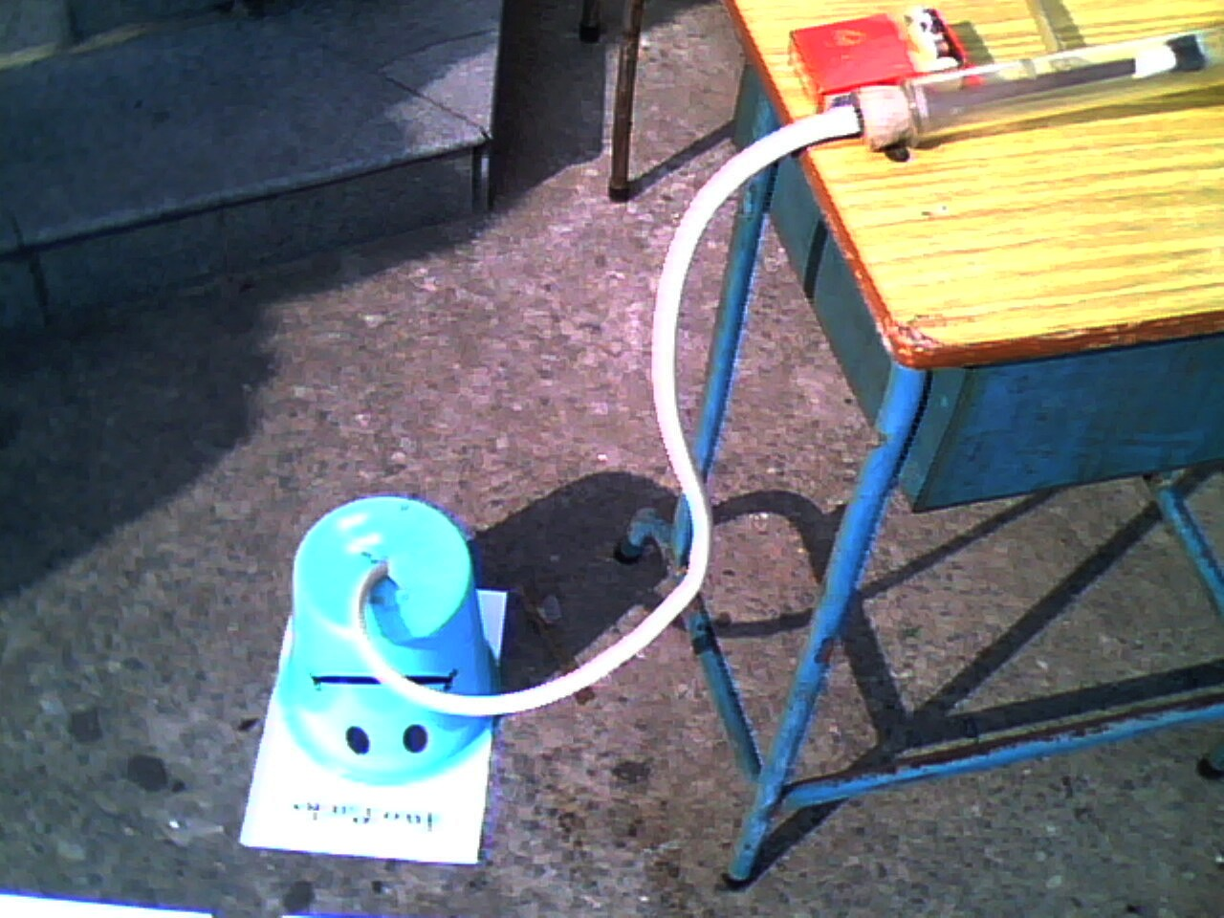
The Smoking Machine

Slide 16
For the demonstration of the machine, let’s go to the lab where the machine can operate in relative safety…

Slide 17
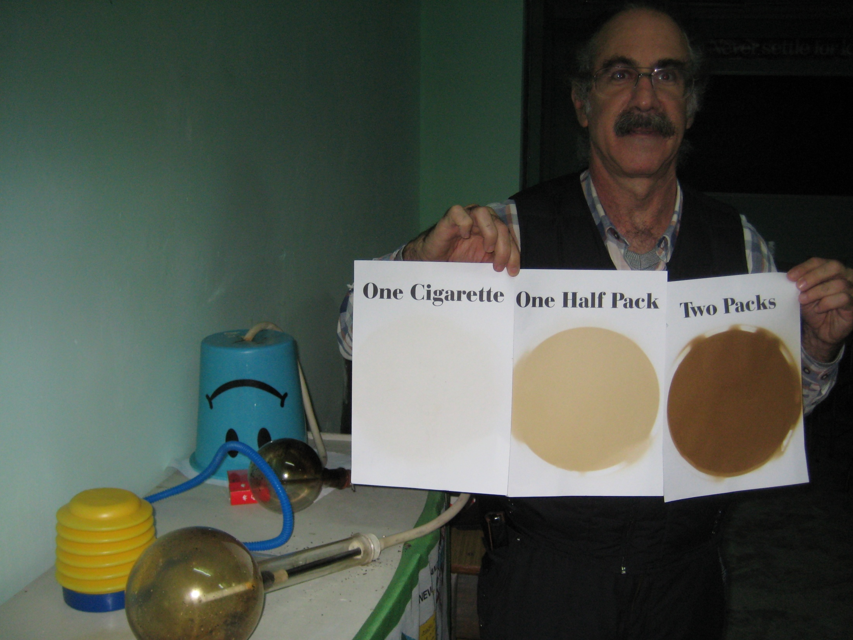
The Smoking Machine
Results:
Notes:
So what are the results?

Slide 18
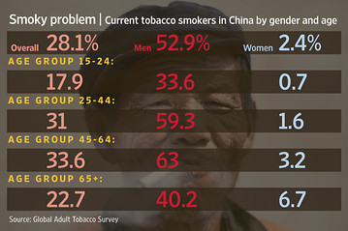
Notes:
From http://www.cdc.gov/mmwr/preview/mmwrhtml/00017511.htm :
“Mass media campaigns also influence smoking behavior by changing awareness, knowledge, and attitudes of smokers (6).“
(6) Flay BR. Mass media and smoking cessation: a critical review. Am J Public Health 1987;77:153-60

Slide 19
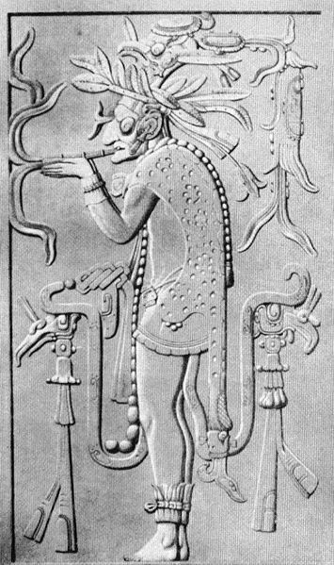
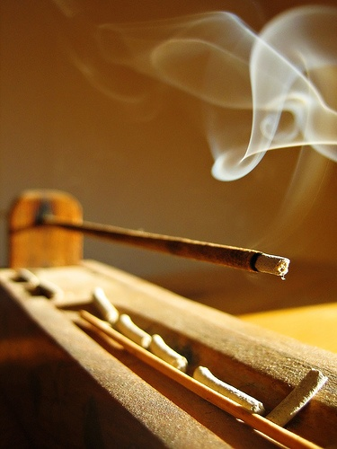
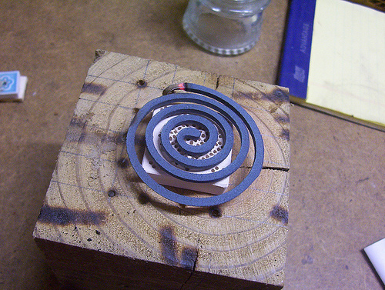
Some History of Smoking
An ancient practice
In the Americas: 5000 BC
Incense in China: pre-historic
Global: 1500s
1560: Jean Nicot introduced tobacco to France
Chongzhen (1627–1644) banned smoking during the Ming dynasty

Slide 20
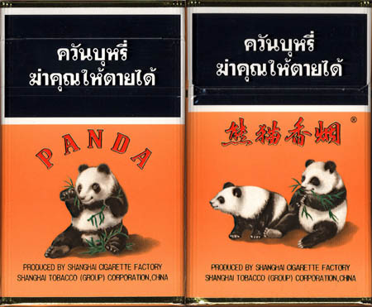
Some History of Smoking
1638: Possessing, using or selling tobacco in China will be punished by decapitation
1842: China Opium War
1915: “The Tobacco Project”
1947: Mao liked 555; Kai Shek liked Big Double Nine; Zhou Enlai liked Zhadan; Deng liked Panda (700元/pack)

Slide 21
Thus, by 1947, smoking and its role in Guanxi (关系) was firmly established as a component of Chinese culture.

Slide 22
Modern History of Smoking
1982: The State Tobacco Monopoly (STM) controls tobacco.
As of January, 2003, STM operates 123 cigarette plants with annual output of 500 billion Yuan. It employs about 500,000 workers and produces 38 per cent of the world’s cigarettes.
7.5% Government Revenue was tobacco tax.

Slide 23
Modern History of Smoking
1994: Tobacco Control Begins in China. China institutes restrictions on tobacco advertising, puts health warnings on cigarette packs and sanctions anti-smoking education efforts.

Slide 24
Modern History of Smoking
1997: China is by far the largest producer of cigarettes in the world; the second largest producer is the United States. In 1997 China produced an estimated 1.7 trillion pieces, almost two and one half times the 720 billion pieces produced in the United States. The United States is by far the largest cigarette exporting nation in the world, with exports in 1997 estimated about 217 billion pieces, or 21% of the world total. China is the largest consumer market in the world, with over 300 million smokers consuming 1.7 trillion cigarettes in 1997.

Slide 25
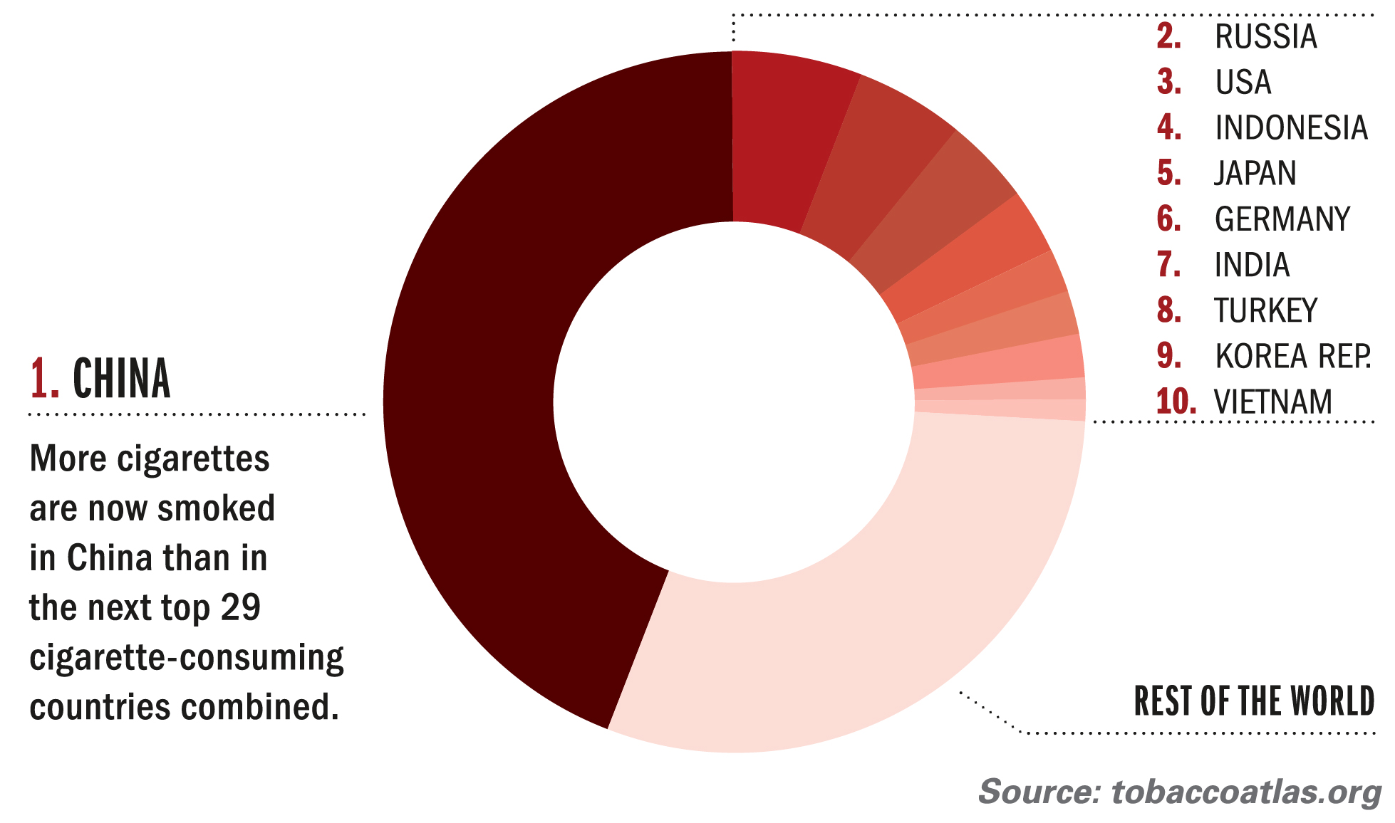
In 2013, an average smoker in China smoked 22 cigarettes a day, nearly 50% more than in 1980.

Slide 26
What’s in a cigarette?
A cigarette may look harmless enough - tobacco leaves covered in classic white paper. But when it burns, the innocent-looking fluffy white clouds that look like pure cotton contain a dangerous cocktail of about 4,000 chemicals including:
  at least 80 cancer-causing chemicals
  hundreds of other poisons.
  nicotine, a highly addictive drug, and many additives designed to make cigarettes taste nicer and keep smokers hooked.

Slide 27
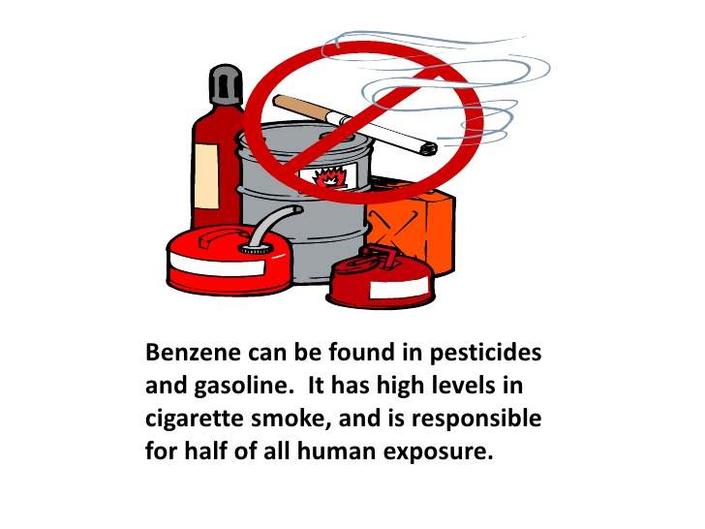
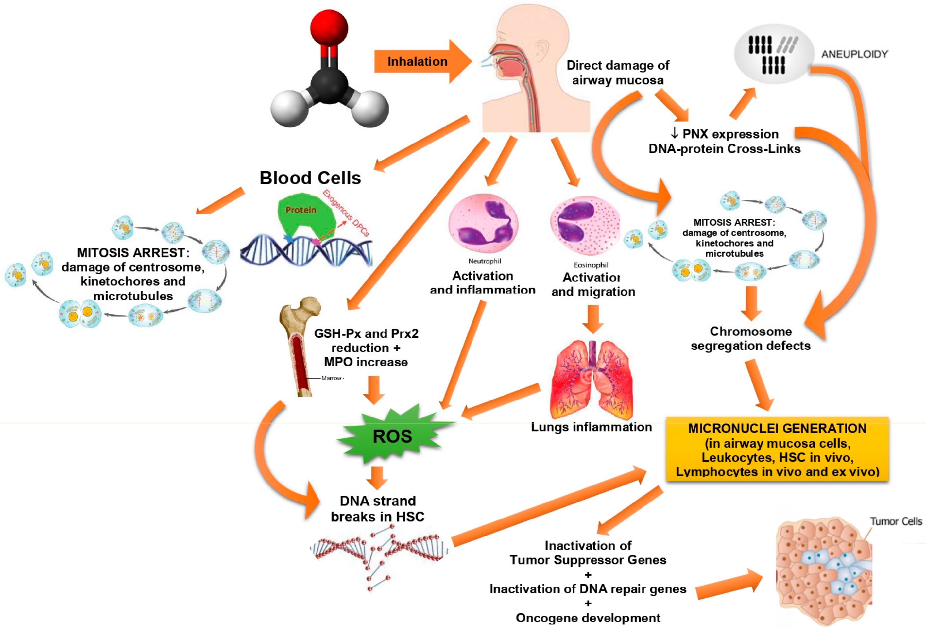
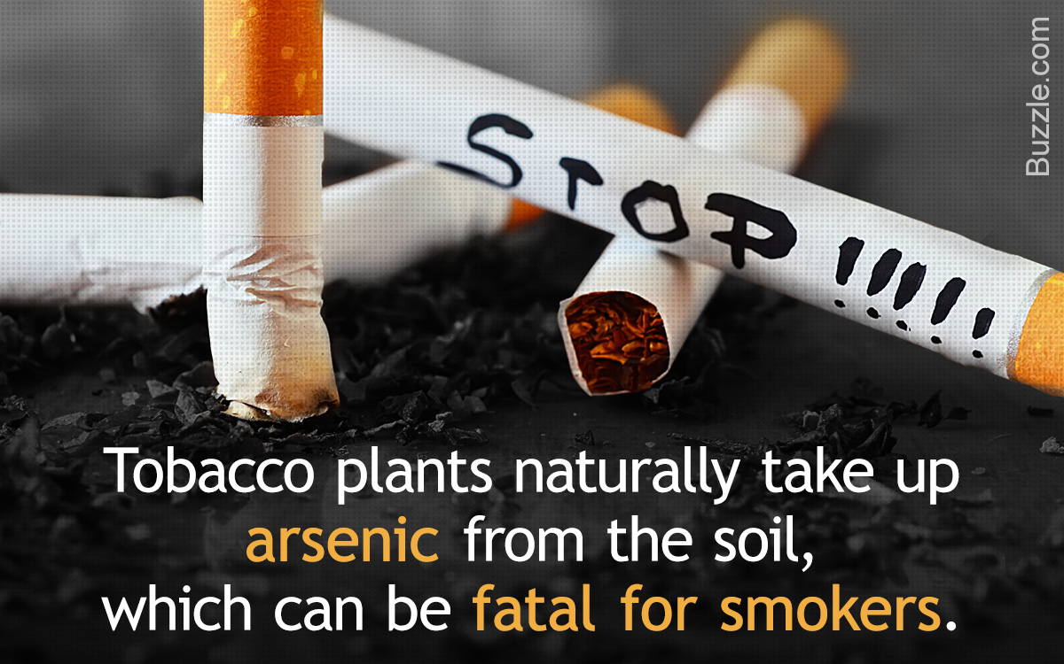
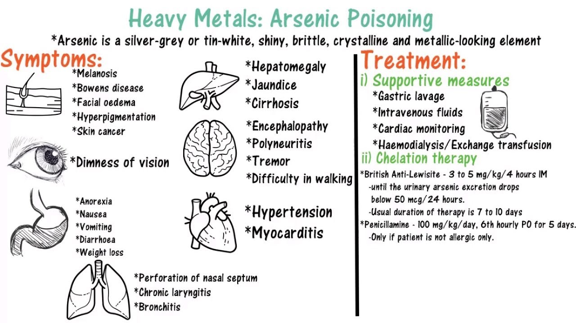
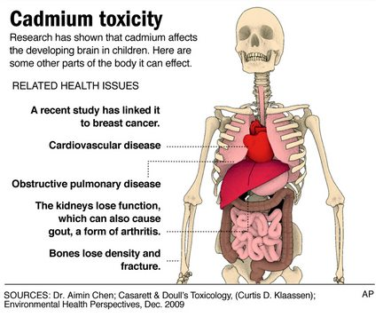
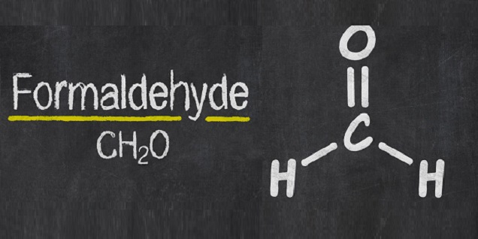
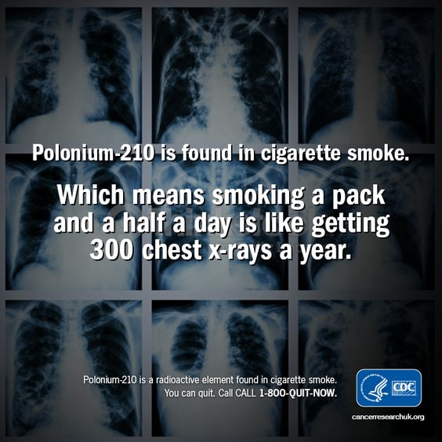
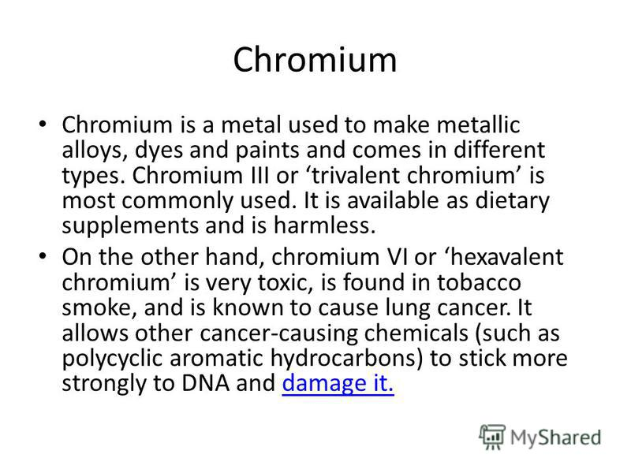

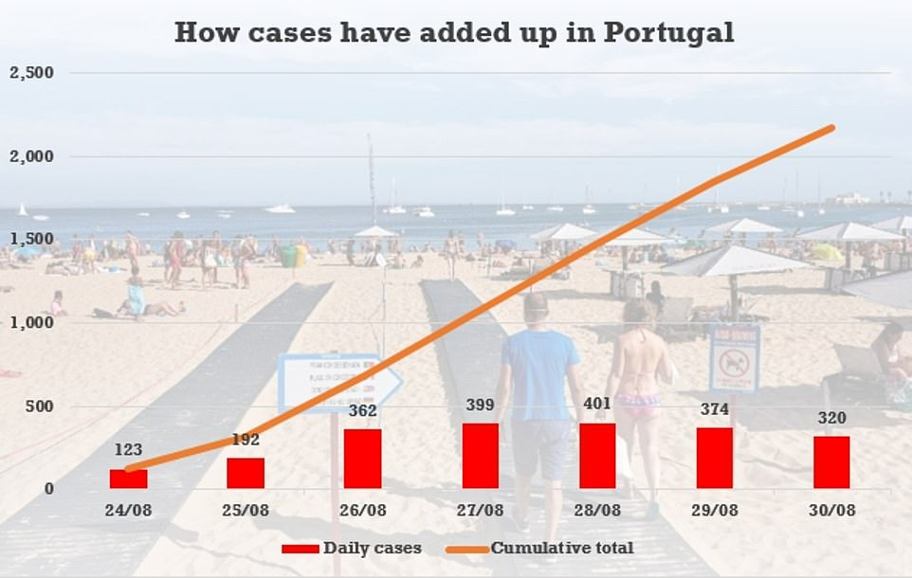
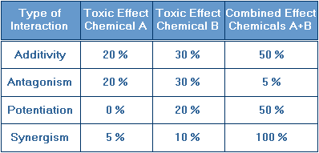
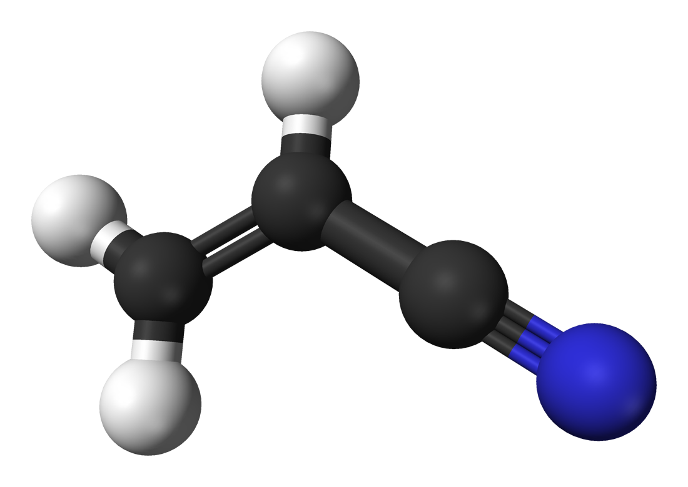
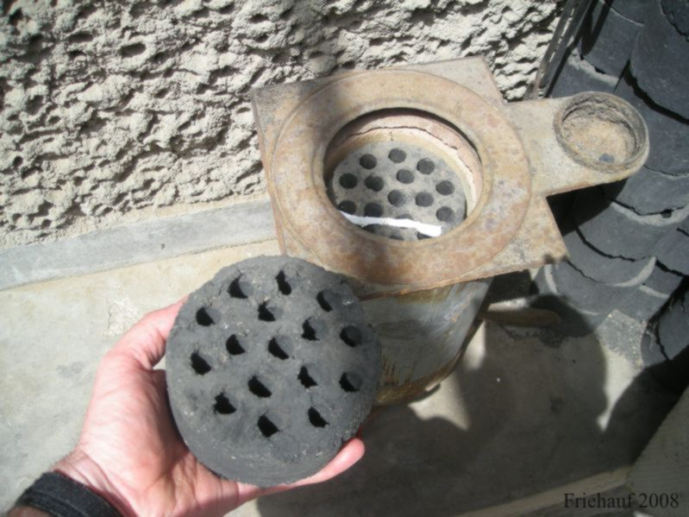
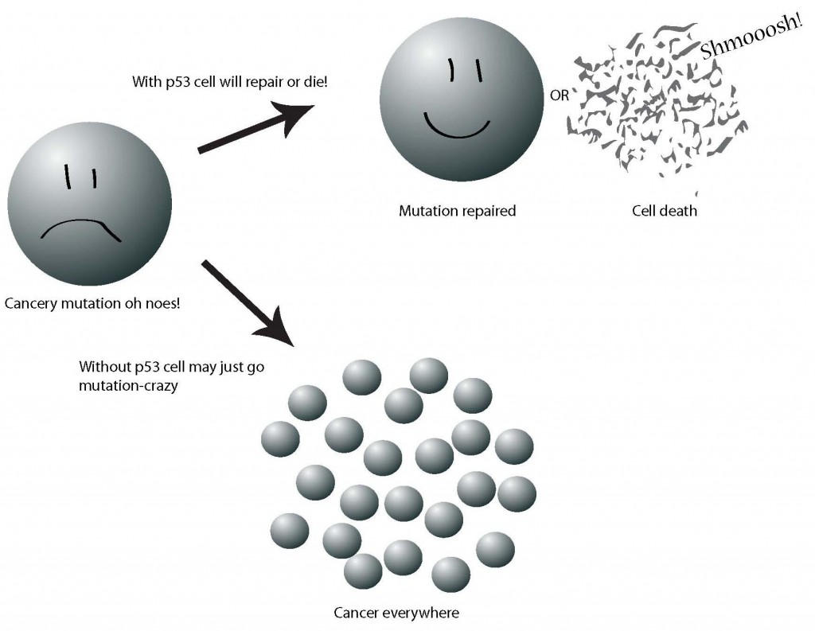
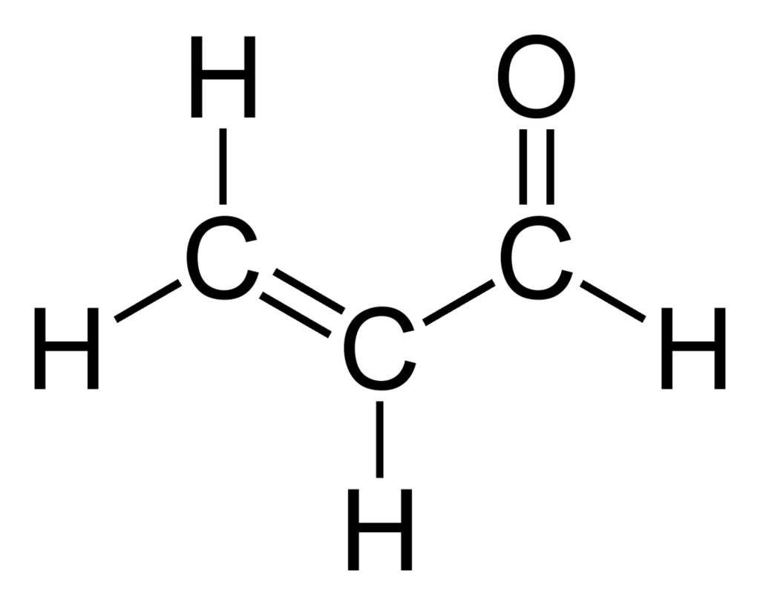
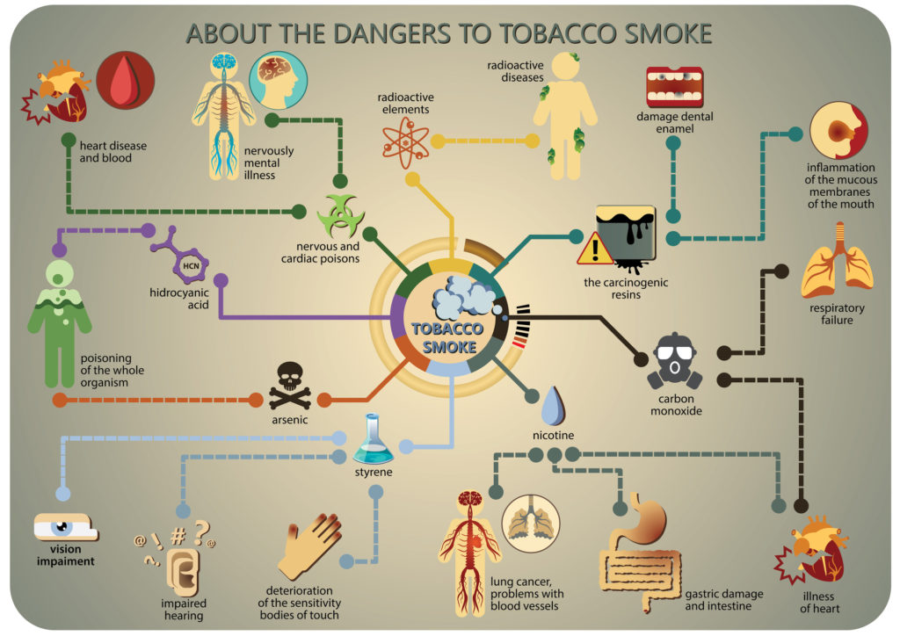
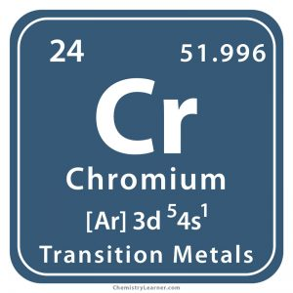
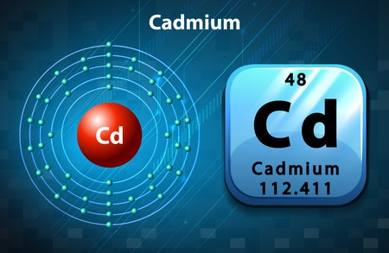
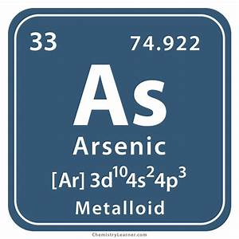
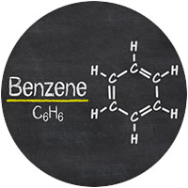
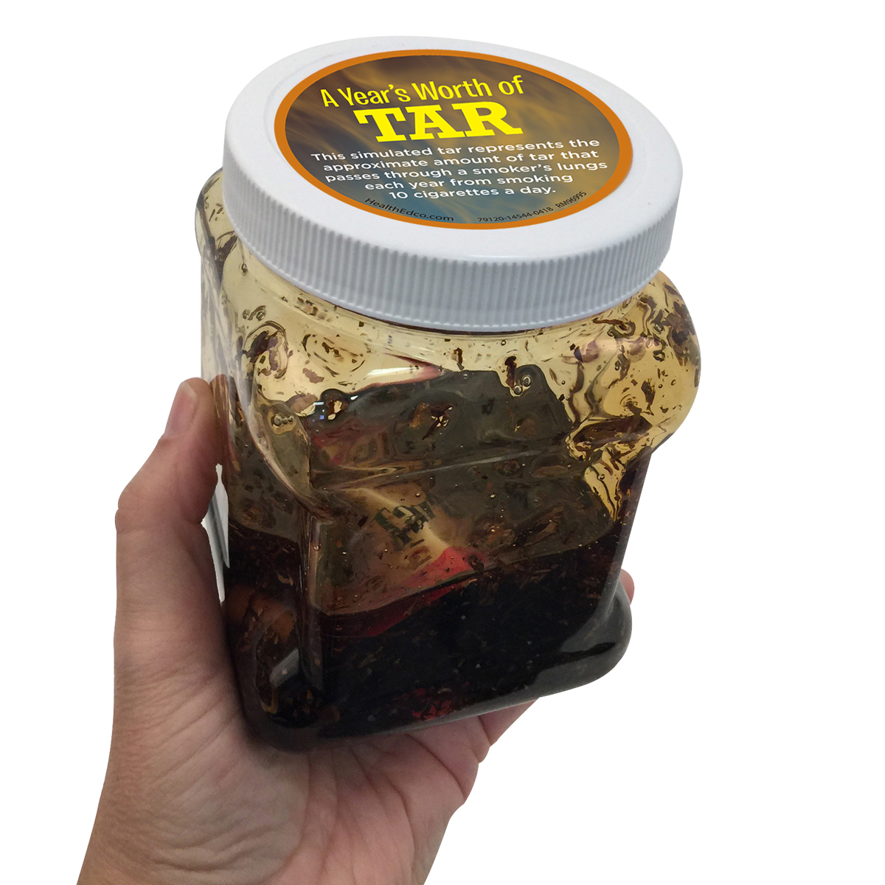
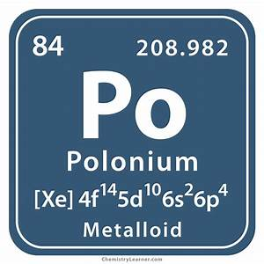
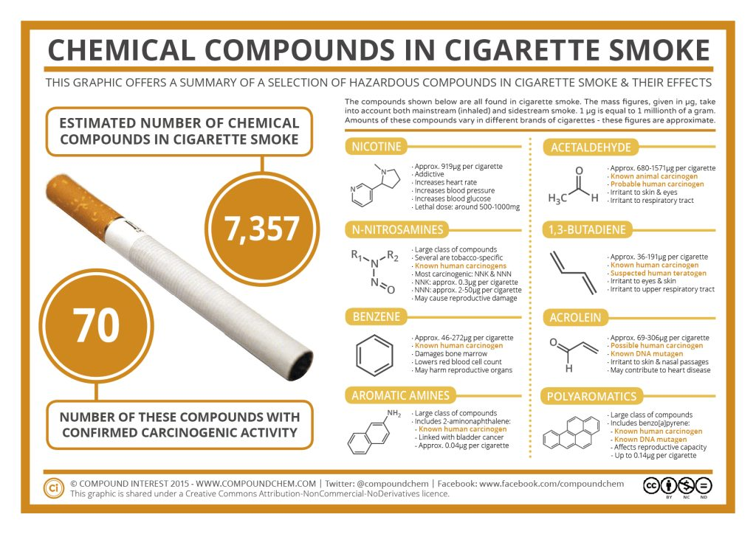
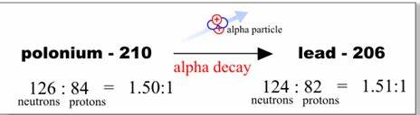

What’s in a cigarette?
Acrolein (ə-krōʹ-lē-ĭn) is the simplest unsaturated aldehyde.
Connections exist between acrolein gas in the smoke from tobacco cigarettes and the risk of lung cancer.
Acrolein contributes 40 times more non-cancer causing punch than the next component, hydrogen cyanide. The acrolein content in cigarette smoke depends on the type of cigarette and added glycerin, making up to 220 µg acrolein per cigarette.
Importantly, while the concentration of the constituents in mainstream smoke can be reduced by filters, this has no significant effect on the composition of the side-stream smoke where acrolein usually resides, and which is inhaled by passive smoking.
1,3-Butadiene has been designated a Group 1 carcinogen ('carcinogenic to humans') by IARC, and has also been listed as a carcinogen by the Agency for Toxic Substances Disease Registry and the US EPA.
Some researchers have concluded it is the most potent carcinogen in cigarette smoke, twice as potent as the runner up acrylonitrile.
Exposure can occur from automobile exhaust; polluted air and water near chemical, plastic or rubber facilities; cigarette smoke; and ingestion of foods that are contaminated from plastic or rubber containers.
This brings up the concept of “cumulative” or “chronic” exposure.
This also brings up the concept of “synergy,” “synergistic.”
A polycyclic aromatic hydrocarbon (PAH) is a hydrocarbon that is composed of multiple aromatic rings. The simplest such chemical is naphthalene, having two aromatic rings.
In industrial countries, people who smoke tobacco products, or who are exposed to second- and third hand smoke, are among the most highly exposed groups; tobacco smoke contributes to 90% of indoor PAH levels in the homes of smokers.
Burning solid fuels such as coal and biofuels in the home for cooking and heating is a dominant global source of PAH emissions that in developing countries leads to high levels of exposure to indoor particulate air pollution containing PAHs, particularly for women and children who spend more time in the home or cooking.
Cancer is a primary human health risk of exposure to PAHs. Exposure to PAHs has also been linked with cardiovascular disease and poor fetal development.
One chemical, BAP, directly damages p53, a gene that normally protects our body against cancer.
Acrylonitrile is an organic compound with the formula C₃H₃N
( CH2CHCN ), consisting of a vinyl group −CH=CH₂ linked to a nitrile −C≡N .
It is reactive and toxic at low doses.
It is classified as a Class 2B carcinogen (possibly carcinogenic) by the International Agency for Research on Cancer (IARC),
Cigarette smoke exposes people directly if they smoke or inhale smoke. Routes of exposure include inhalation, oral, and to a certain extent dermal uptake (tested with volunteer humans and in rat studies).
Repeated exposure causes skin sensitization and may cause central nervous system and liver damage.
formaldehyde
Helium
Cancer-causing chemicals in tobacco smoke.
  Tar - a mixture of dangerous chemicals
  Arsenic - used in wood preservatives
  Benzene - an industrial solvent, refined from crude oil
  Cadmium - used in batteries
  Formaldehyde - used in mortuaries and paint manufacturing
  Polonium-210 - a highly radioactive element
  Chromium - used to manufacture dye, paints and alloys
  1,3-Butadiene - used in rubber manufacturing
  Acrylonitrile - used in the synthesis of certain nylons and rubber
  Polycyclic aromatic hydrocarbons - a group of dangerous DNA-damaging chemicals
  Nitrosamines - another group of DNA-damaging chemicals
  Acrolein - formerly used as a chemical weapon
cu·mu·la·tive (kyo͞om′yə-lā′tĭv, -yə-lə-tĭv) adj.
1. Increasing or enlarging by successive addition.
2. Acquired by or resulting from accumulation.
syn·er·gy (sĭn′ər-jē) n. pl. syn·er·gies
The interaction of two or more agents or forces so that their combined effect is greater than the sum of their individual effects.

Slide 28
What’s in a cigarette?
Other poisons in cigarette smoke.
  Hydrogen cyanide - used as an industrial pesticide
  Carbon monoxide - found in car exhausts and used in chemicals manufacturing
  Nitrogen oxides - a major component of smog
  Ammonia - used to make fertilisers and explosives
  More poisons

Slide 29
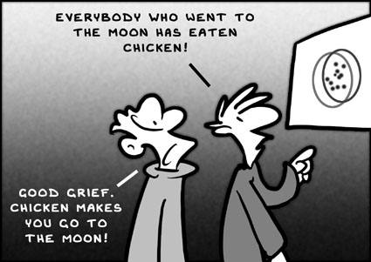
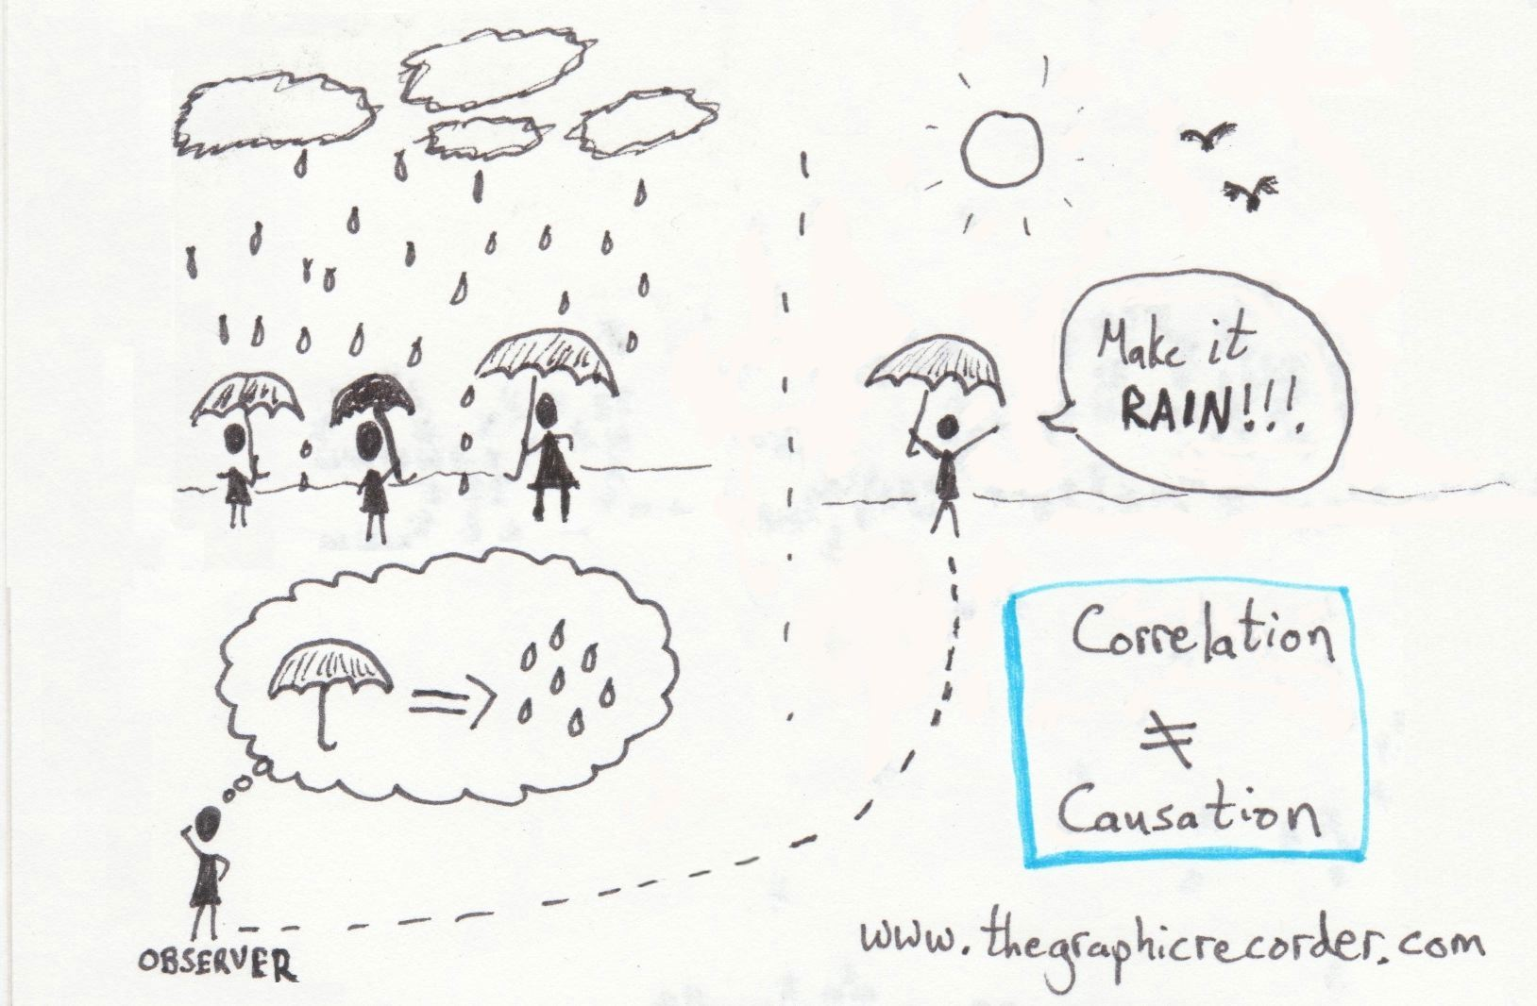
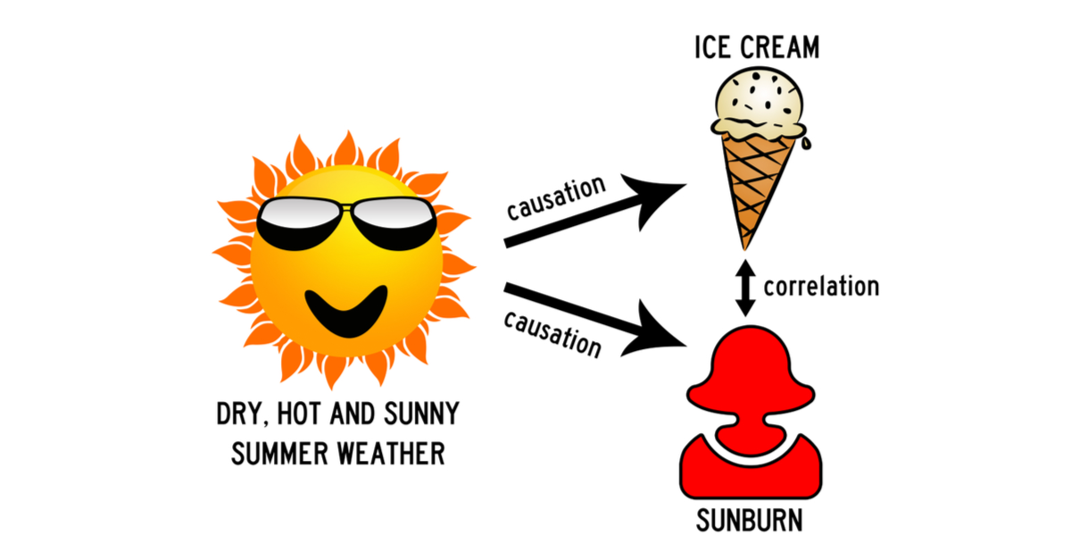
What about Health?
First, it is important to understand the distinction between causation and correlation.
cau·sa·tion (kô-zā′shən) n.
1. The act or process of causing.
2. A cause.
3. Causality.
cor·re·la·tion (kôr′ə-lā′shən, kŏr′-) n.
1. A relationship or connection between two things based on
co-occurrence or pattern of change.
2. Statistics The tendency for two values or variables to change together, in
either the same or opposite way: As cigarette smoking increases, so does the incidence of lung cancer, indicating a positive correlation.
3. An act of correlating or the condition of being correlated.

Slide 30
What about Health?
1929: Fritz Lickint published evidence of a lung cancer-tobacco link; only correlation was established; it did not prove causation.
Before World War I, lung cancer was considered to be a rare disease.
1950: Richard Doll published a close link between smoking and lung cancer. This was the first proof of causation.

Slide 31
What about Health?
1964: US Surgeon General’s Report on Smoking and Health
This was long after the culture of smoking was established in China.

Slide 32
Cigarettes cause more than one in five American deaths.
In 2005, 1.95 trillion cigarettes were smoked by 320 million Chinese smokers of whom 50 million were under-age.
60 per cent of male Chinese doctors smoke.

Slide 33
The World Health Organization says only 25 per cent of Chinese adults have a comprehensive understanding of the health risks of smoking.
If you think that is a rural issue think again: more than 95 per cent are not aware that smoking causes cervical cancer in women!

Slide 34
More than one million (1,000,000) Chinese die each year from smoke-related illness.
Of that million, more than ten percent, or more than100,000, are women, children, and infants who are not smokers!
Estimates place the number of infant and child deaths at around 28,000 per year. Every year. As smoking in Chinese homes may be more prevalent than in U.S. homes, this figure based on 28% of the 100,000 non-smoker deaths may actually be higher.

Slide 35
“There is no safe level of exposure to second-hand smoke.”… “Ventilation equipment is ineffective in reducing the harm from exposure to second-hand smoke.” These quotes are from the “2007 China Tobacco Control Report” of the Chinese Ministry of Health. Stated another way: if you can smell cigarette smoke, your health is being compromised; if someone is smoking anywhere in a building, the health of everyone in that building is being compromised.

Slide 36
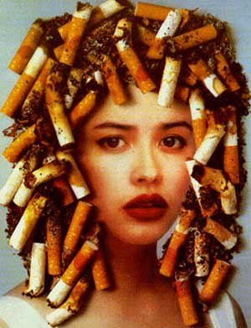
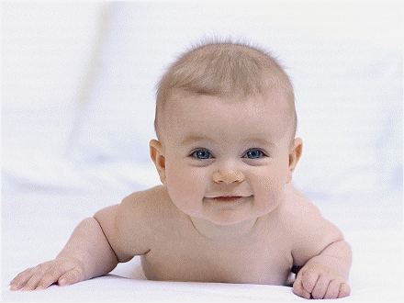
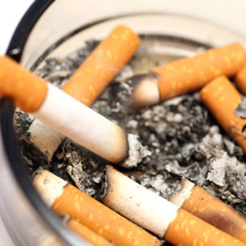
Some Basic Definitions
Third-hand Smoke is the outgassing of tobacco smoke contamination of a space that remains after the smoke has dissipated in the air. This contamination includes clothes, hair, skin, walls, floors, furniture, etc.
Third-hand smoke has been shown to be just as dangerous as second-hand smoke, and may continue to outgas for as long as five years.
Smoking in an elevator for just one floor may leave smoke in the elevator for up to 30 minutes.
Smoke odor right here

Slide 37

Some Basic Definitions
Outgassing (sometimes called offgassing, particularly when in reference to indoor air quality) is the slow release of a gas that was trapped, frozen, absorbed or adsorbed in some material.
(Mexican food uses lots of beans, and in the West, we know that if you eat lots beans, you may get lots of gas!)

Slide 38
What about smoking in a car with windows rolled down?
Even when the car is moving, the level of smoke can be twice the pollution in Beijing on a bad day.
In some States and countries, smoking in a car with children present is considered child abuse, and the offenders may be arrested and the children placed in foster homes.

Slide 39
When the father comes home from work and he has the smell of cigarette smoke on his clothes and he picks up his infant baby for a hug, that baby is breathing in the third-hand smoke next to its nose, and could die that very night. When the mother who works in a smoke-filled environment comes home from work and she has the smell of cigarette smoke on her clothes and she picks up her infant baby for a hug, that baby is breathing in the third-hand smoke next to its nose, and could die that very night. The parent or the adult may have just committed murder.

Slide 40
Yes, it is that serious.
28,000 Chinese infants and children die each year from exposure to second-hand and third-hand smoke.

Slide 41
This brings us to today’s topic:
The Hidden Power of Remorse

Slide 42
What I have just done is accused some of you and some people you know of murder.
Be angry, but not at me; I’m just the messenger.
It is the tobacco industry that lied to you, lied to me, to all of us.
But don’t let the remorse destroy you.
Use its power to motivate you as it has me, to help others.

Slide 43
What Can You Do?
If you are a smoker:
You have a right to smoke, but please honor the rights of the non-smoker to clean air and personal health.
If you wish to smoke in the presence of others, politely ask first if it is OK.

Slide 44
What Can You Do?
If you are a smoker:
Honor all people (women and children especially) by not smoking around them.
Avoid smoking in halls, stairwells, and bathrooms; smoke may linger there and cause health problems for others (third-hand smoke).
Second-hand smoke can persist for up to 30 minutes; third-hand smoke can persist for up to five years!

Slide 45
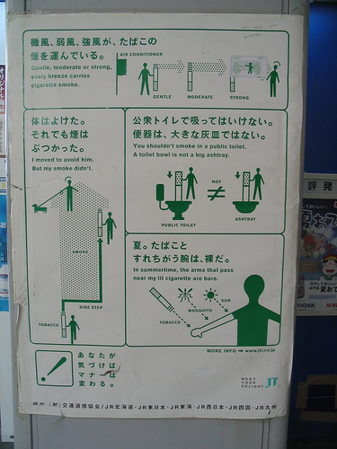
What Can You Do?
If you are a smoker:
If you smoke outside, keep at least 10 meters away from doors and windows; try to be downwind of buildings.
When finished smoking, extinguish the cigarette before disposing of it in a proper receptacle: 100 million smoldering cigarette butts contribute significantly to air pollution in China.

Slide 46
What Can You Do?
If you are a smoker:
Quit.
When you quit, be sure to invite friends and family to support your efforts. It is difficult to quit when others are helping you, but it is even more difficult to do it alone.
Do not be discouraged; most have to try at least five times before being successful.
And even then, less than one in five succeeds.

Slide 47
You are man enough to smoke; are you man enough to not smoke around women and children and other living things?
You are man enough to smoke; are you man enough to support our China into becoming a healthier Nation?

Slide 48
What Can You Do?
If you are a non-smoker:
Do NOT be angry at smokers. It is not their fault! They were lied to just like you were.
Avoid smoke-filled rooms.
Politely ask smokers to refrain from smoking around you.

Slide 49

What Can You Do?
If you are a non-smoker:
Immediately rescue children and infants from smokers, no questions asked!
Remember, smoke around a child is like someone pointing a loaded gun at their head. It is not a time for being diplomatic.

Slide 50

What Can You Do?
If you are a non-smoker:
Ask for smoke-free tables in restaurants, even if they do not have any.
Place no smoking signs on your table when you are at a restaurant.
Put up no smoking signs at home and at work.

Slide 51

What Can You Do?
If you are a non-smoker:
Encourage your workplace to become a non-smoking environment.
Encourage health care facilities to enforce their no smoking rules.

Slide 52


What Can You Do?
If you are a non-smoker:
Encourage educational institutions to implement no smoking policies for teachers as well as students.
Discuss the facts about smoking with your children.
If someone you know tries to quit, make sure they know you support them.

Slide 53



Let’s Get Personal!

Slide 54






Class Project Ideas
Perhaps you can participate in the May 31 Smoke-free day.
Perhaps you can join with a school in another country to have an online project.
How about a cigarette butt cleanup competition?
Perhaps you can…

Slide 55

That’s All, Folks!

